Slide 1
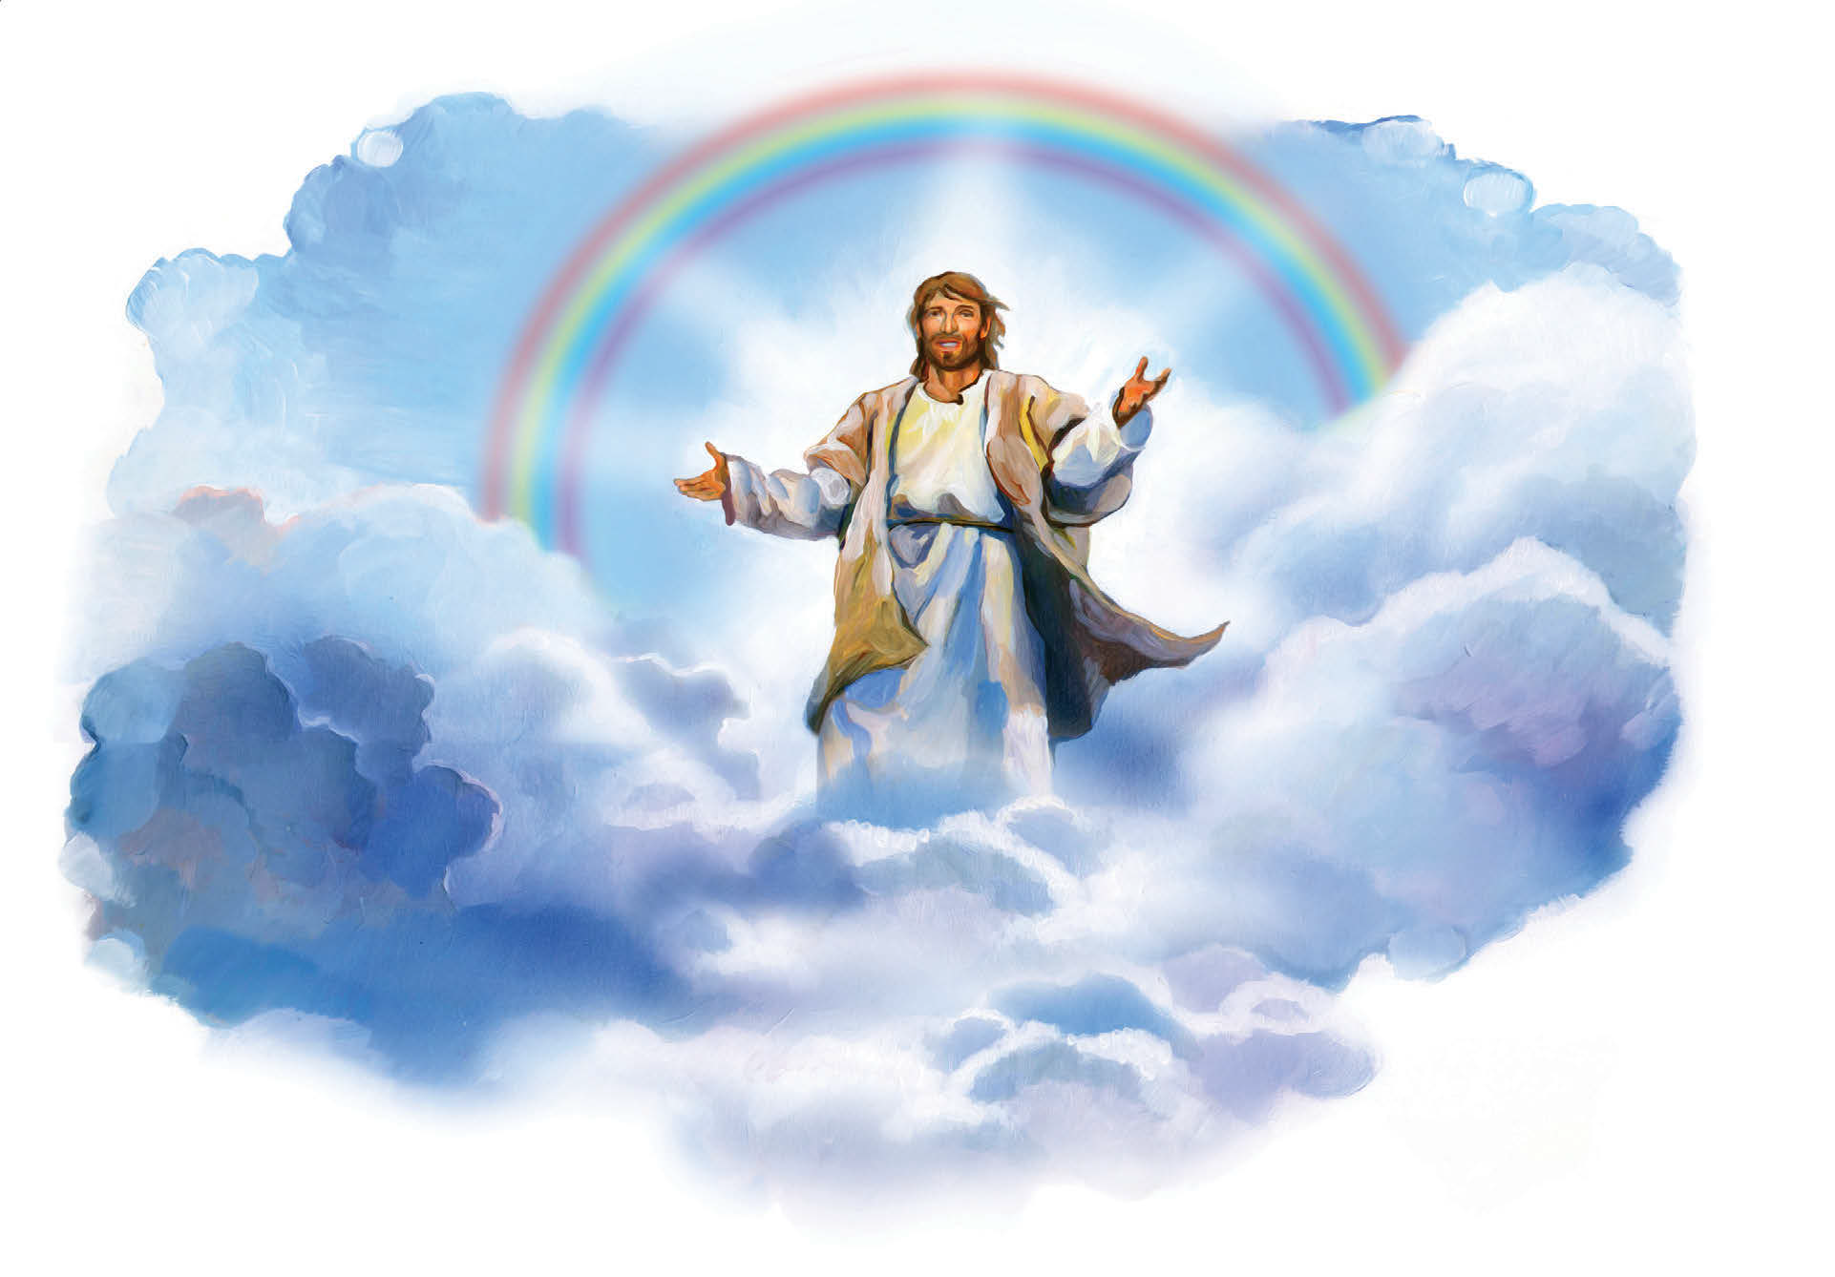
What the Bible Says About Christ’s Return

Slide 2
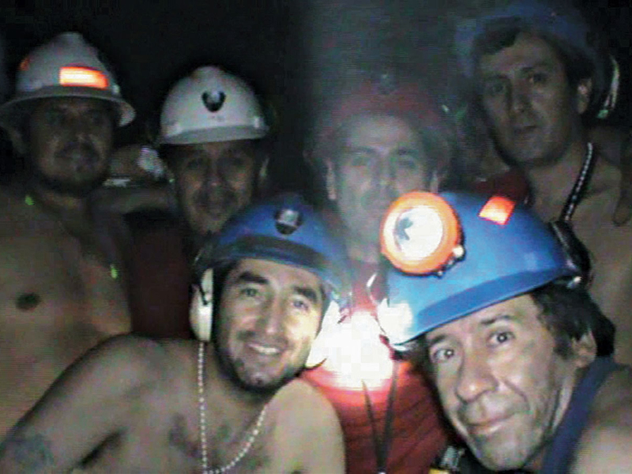
Notes:
In 2010 thirty-three miners were trapped alive deep underground in a copper and gold mine in Northern Chile. Seventeen days after the collapse, as workers removed a drill bit which had just completed a bore hole, they found a hand-written note that said “We are well in the shelter, the thirty-three.” Together these miners survived a record sixty-nine days underground!

Slide 3
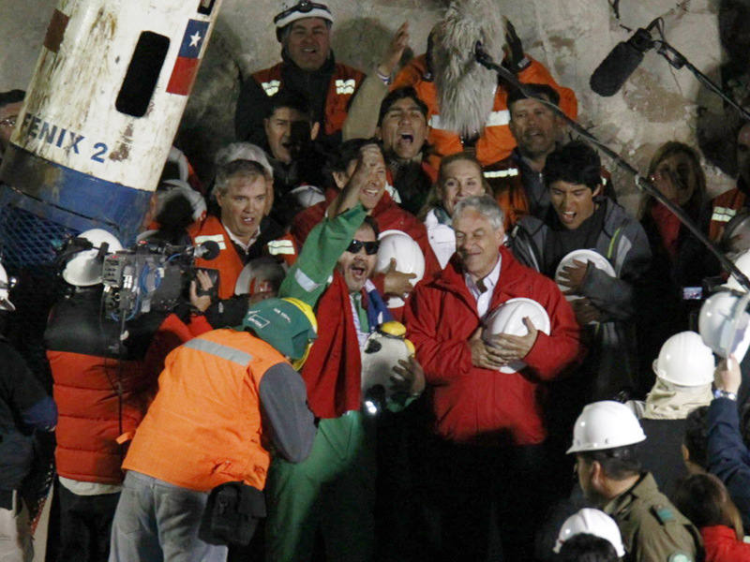
Notes:
Finally the day came when the preparations were completed, and the miners were to be winched to the surface one by one. An estimated one billion people watched the television feed live, as jubilant families and national leaders greeted the heroic men emerging from that hole. The last miner, upon exiting the capsule, held up a sign that read “Mission Accomplished Chile.” The rescue had been a resounding success!

Slide 4
Romans 15:4
13 Now may the God of hope fill you with all joy and peace in believing, that you may abound in hope by the power of the Holy Spirit.

Slide 5
Notes:
(Text: John 14:1-3)“Let not your heart be troubled; you believe in God, believe also in Me.

Slide 6
Notes:
In My Father’s house are many mansions; if it were not so, I would have told you. I go to prepare a place for you.

Slide 7
Notes:
And if I go and prepare a place for you, I will come again,

Slide 8
Notes:
and receive you to Myself; that where I am, there you may be also.” John 14:1-3.

Slide 9
Mark 14:61-62
61 Again the high priest asked Him, saying to Him, “Are You the Christ, the Son of the Blessed?” 62 Jesus said, “I am. And you will see the Son of Man sitting at the right hand of the Power, and coming with the clouds of heaven.”

Slide 10
Notes:
(Text: Acts 1:9-11)“Now when He had spoken these things, while they watched, He was taken up, and a cloud received Him out of their sight.

Slide 11
Notes:
And while they looked steadfastly toward heaven as He went up, behold two men stood by them in white apparel

Slide 12
Notes:
who also said, ‘Men of Galilee, why do you stand gazing up into heaven?

Slide 13
Notes:
This same Jesus who was taken up into heaven will so come in like manner as you saw Him go into heaven.’” Acts 1:9-11.

Slide 14
Notes:
(Text: Titus 2:13)“Looking for that blessed hope and glorious appearing of our great God and Savior Jesus Christ.” Titus 2:13.Paul wrote this encouraging letter to Titus, his “true son in the faith,” to remind Titus of the “glorious coming” of our Lord.

Slide 15
Jude 14-15
14 Now Enoch, the seventh from Adam, prophesied about these men also, saying, “Behold, the Lord comes with ten thousands of His saints..."

Slide 16
Revelation 22:12
12 And behold, I am coming quickly, and My reward is with Me.
Notes:
From beginning (Enoch) to end (Revelation) Jesus is coming.

Slide 17
Notes:
The most talked about event in the New Testament is the second coming of Christ. About one of every 25 verses has something to do with that event.Christ spent more time talking about that event than any other topic in the New Testament.One of the best-known promises of Jesus is found in John chapter fourteen:

Slide 18
Notes:
(Text: Revelation 1:7)“Behold, He is coming with clouds, and every eye will see Him...”No one but Jesus can make an appearance like this!

Slide 19
Notes:
(Text: Matthew 24:27)“For as the lightning comes from the east and flashes to the west, so also will the coming of the Son of Man be.” Matthew 24:27.In fact, in Revelation 1:7 we read,

Slide 20
Luke 17:24
24 For as the lightning that flashes out of one part under heaven shines to the other part under heaven, so also the Son of Man will be in His day.

Slide 21
Matthew 28:2-4
2 And behold, there was a great earthquake; for an angel of the Lord descended from heaven, and came and rolled back the stone from the door, and sat on it.

Slide 22
Matthew 28:2-4
3 His countenance was like lightning, and his clothing as white as snow. 4 And the guards shook for fear of him, and became like dead men.

Slide 23
Notes:
(Text: Matthew 25:31)Jesus said, “When the Son of Man comes in His glory, and all the holy angels with Him, then He will sit on the throne of His glory.” Matthew 25:31.

Slide 24
Psalm 50:3
Our God shall come, and shall not keep silent; A fire shall devour before Him, And it shall be very tempestuous all around Him.

Slide 25
Notes:
(Text: 1 Thessalonians 4:16)“For the Lord Himself will descend from heaven with a shout, with the voice of the archangel,

Slide 26
Notes:
and with the trumpet of God. And the dead in Christ will rise first.” 1 Thessalonians 4:16.

Slide 27
Revelation 20:5
5 But the rest of the dead did not live again until the thousand years were finished.

Slide 28
John 5:28-29
28 Do not marvel at this; for the hour is coming in which all who are in the graves will hear His voice 29 and come forth—those who have done good, to the resurrection of life, and those who have done evil, to the resurrection of condemnation.

Slide 29
Matthew 24:40-44
40 Then two men will be in the field: one will be taken and the other left. 41 Two women will be grinding at the mill: one will be taken and the other left. 42 Watch therefore, for you do not know what hour your Lord is coming.

Slide 30
Matthew 24:40-44
43 But know this, that if the master of the house had known what hour the thief would come, he would have watched and not allowed his house to be broken into. 44 Therefore you also be ready, for the Son of Man is coming at an hour you do not expect.

Slide 31
Revelation 16:15
15 Behold, I am coming as a thief. Blessed is he who watches, and keeps his garments, lest he walk naked and they see his shame.

Slide 32
Matthew 24:30
30 Then the sign of the Son of Man will appear in heaven, and then all the tribes of the earth will mourn, and they will see the Son of Man coming on the clouds of heaven with power and great glory.

Slide 33
Notes:
(Text: Matthew 24:31)Why does Jesus bring the angels with Him? He gives the answer: “And He will send His angels with a great sound of a trumpet,

Slide 34
Notes:
and they will gather together His elect from the four winds, from one end of heaven to the other.” Matthew 24:31.

Slide 35
Mark 8:38
38 For whoever is ashamed of Me and My words in this adulterous and sinful generation, of him the Son of Man also will be ashamed when He comes in the glory of His Father with the holy angels.

Slide 36
Luke 23:30
30 Then they will begin ‘to say to the mountains, “Fall on us!” and to the hills, “Cover us!”

Slide 37
Notes:
(Text: Revelation 6:14-17)“And the heaven departed as a scroll when it is rolled together;

Slide 38
Notes:
and every mountain and island were moved out of their places.

Slide 39
Notes:
And the kings of the earth, and the great men, and the rich men, . . . and the mighty men . . .

Slide 40
Notes:
hid themselves in the dens and in the rocks of the mountains;

Slide 41
Notes:
and said to the mountains and rocks, ‘Fall on us, and hide us from the face of him that sits on the throne’ . . .

Slide 42
Notes:
(Text: Isaiah 25:9)“‘...Lo, this is our God; we have waited for Him and He will save us.’”

Slide 43
Matthew 24:44
44 Therefore you also be ready, for the Son of Man is coming at an hour you do not expect.
Notes:
On April 15, 2012 the world commemorated the one-hundredth anniversary of the sinking of the Titanic. on that fateful night a century before—on April 15, 1912—the unsinkable Titanic sank. The Titantic was an engineering masterpiece. So carefully had this great nine-hundred-foot-long sailing ship been constructed, with sixteen water-tight compartments in a one-sixth mile long hull, that the captain had made a pre-voyage boast, “Not even God Himself could sink her.” The engineers had calculated that even if four of the sixteen compartments should burst, the ship would still float! But on that starry night of April 14, when the luxury liner, with 2,223 people aboard, made a direct hit on an unseen iceberg, five of the compartments were split open and began to sink in the icy sea water. Within a relatively short time, the unsinkable Titanic sunk in the frigid waters of the North Atlantic.

Slide 44
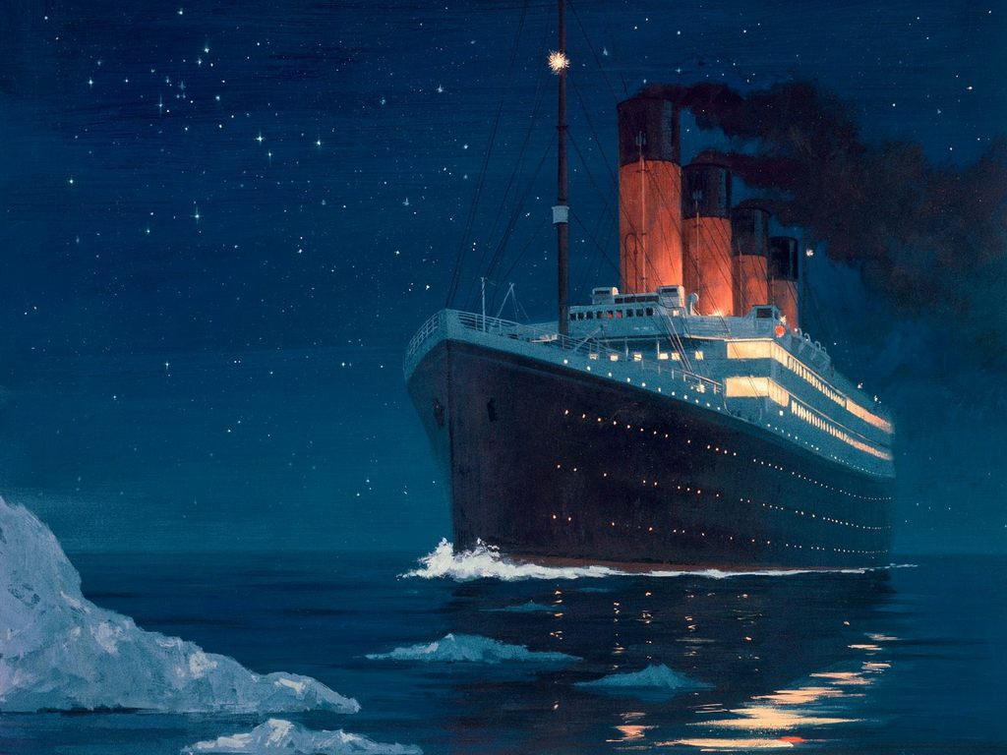
Notes:
Before the crash there was no sign of danger. The cold, dark sea was calm, as smooth as glass, beneath the star-studded heavens. It was an hour before midnight. Some people had gone to bed and slipped into a serene sleep. Others ate in the luxurious dining rooms, listening as the band played soothing songs beneath the decks in the first-class lounge. They were totally unaware that the greatest maritime tragedy in the history of sailing, awaited them in the ice-strewn midnight waters of the North Atlantic. They were totally obvious to the fact that two-thirds of the people on that mighty ship would be dead before the night was over.
The crew of the Titanic received multiple messages of icebergs in the area. Were they so overconfident in the ship’s ability to withstand any crash that they ignored them? Were they too busy with their routine duties to heed the messages? Were they overtired, drowsy, or just plain sleepy because of the lateness of the hour? Only eternity will tell. But this one fact is certain—every person aboard the Titanic was incredibly surprised with the outcome. Not one of them expected the ship to sink and hundreds of lives to be lost.
When Jesus comes again, everyone will be surprised. Not at the manner with all his power and glory and angels with him, but with the timing. The only question that remains is whether you’re going to be pleasantly or unpleasantly surprised. My prayer is that you will be among the people longing for and looking forward to the return of Christ. Baptismal classes begin every Sabbath after church 1st quarter 2015. Next Sabbath we will be studying What The Bible Says About Death.

Slide 45
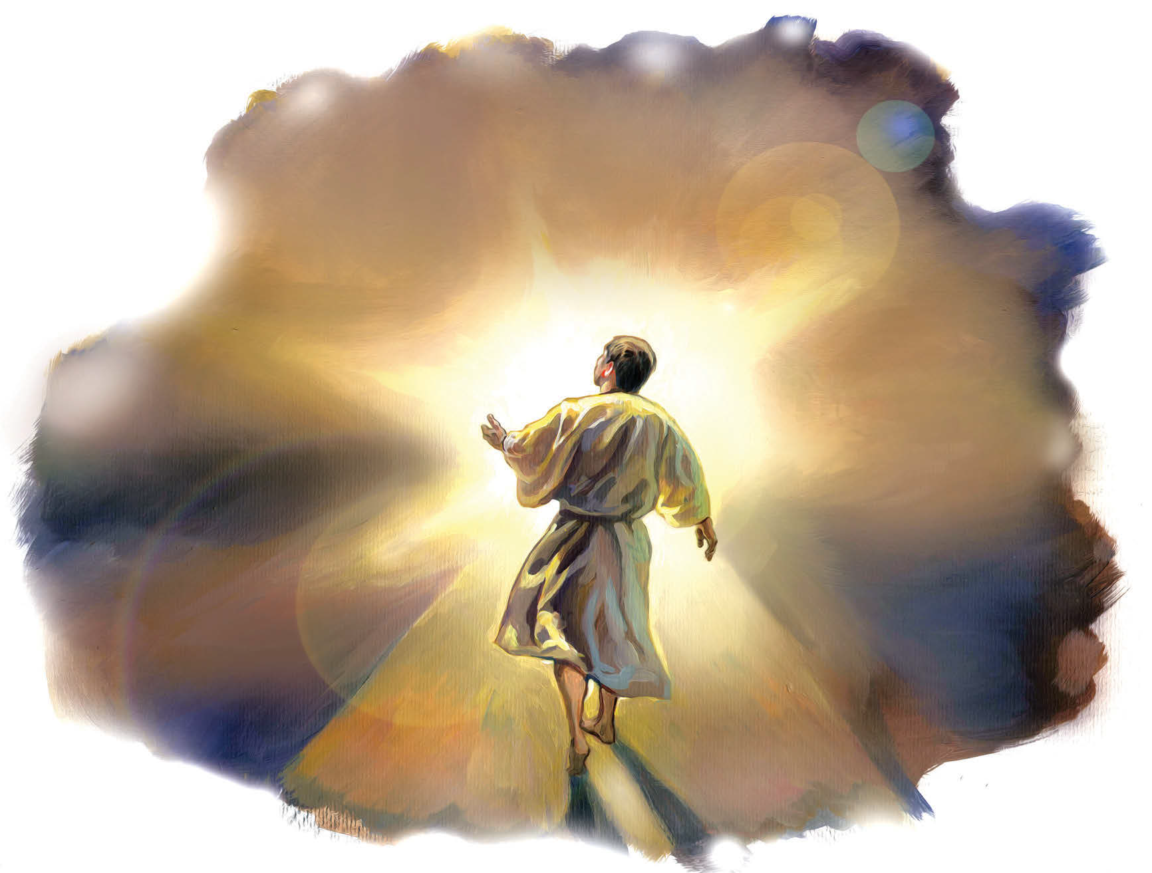
What the Bible Says About Death

