Slide 1
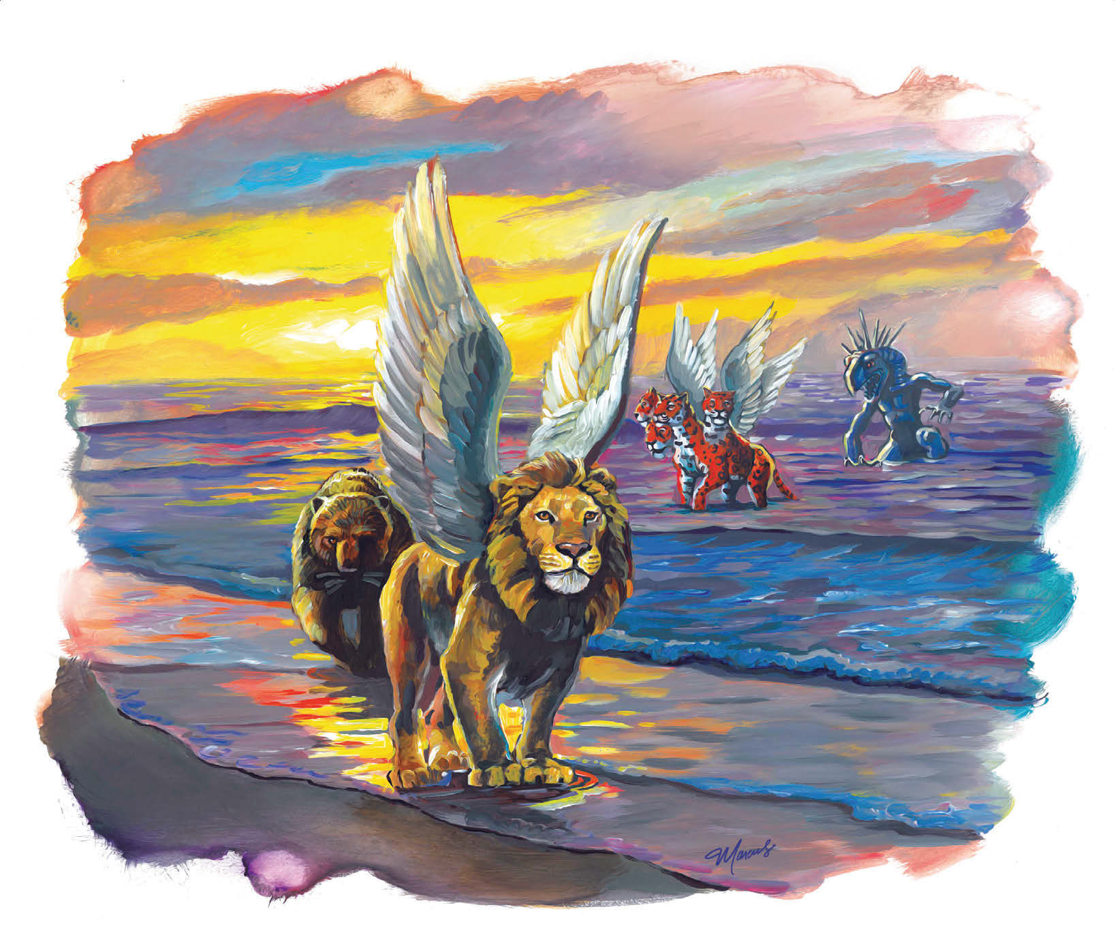
What the Bible Says About the Change of the Sabbath

Slide 2
Notes:
About 350 B.C., the Greek philosopher Aristotle classified the spider as having six legs. Incredibly, for the next 20 centuries it was accepted as fact. Until the biologist Lamarck actually counted and surprised the world by announcing that spiders have eight legs! For 2000 years, no one questioned it! But they were wrong.

Slide 3
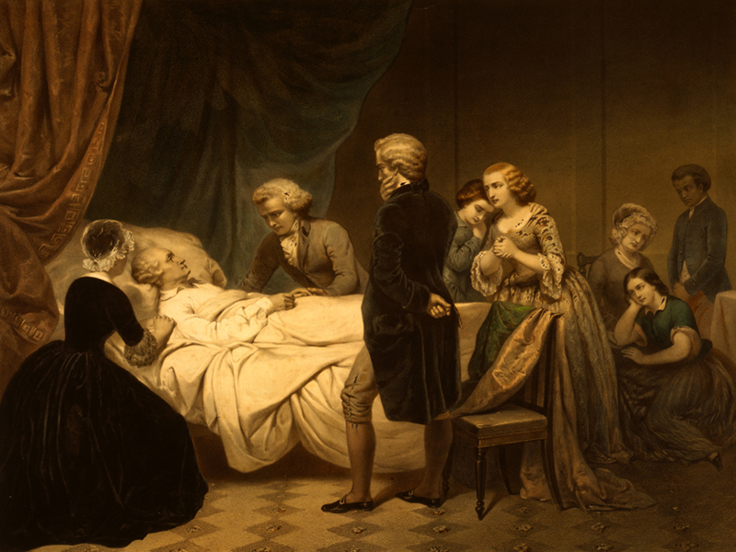
Notes:
At the end of the eighteenth century doctors believed that sickness could be treated by bloodletting, or draining blood from a patient’s body. The first President of the United States, George Washington, nearly died after doctors drained almost two quarts of blood from his veins because he had a sore throat. He needed a cough drop instead! Ricola!

Slide 4
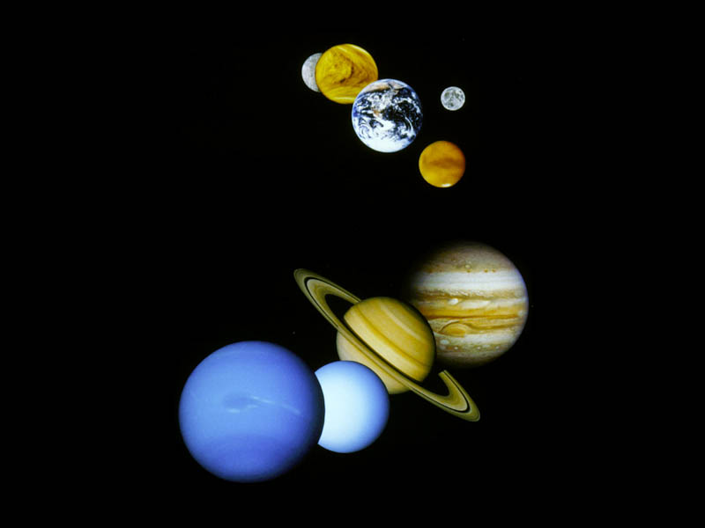
Notes:
For centuries most people believed that the earth was the center of the universe. They believed the sun and all the planets revolved around the earth. Until a scientist named Copernicus said otherwise. Church leaders didn’t agree. But their disagreement didn’t change reality. Sometimes, scientists and doctors and church leaders are wrong. The Sabbath is simply one of those things. Which is why today’s message is entitled What the Bible Says About the Change of the Sabbath.

Slide 5
Notes:
The Bible says in John 1, Hebrews 1, and Colossians 1 that Jesus created everything. If that’s true, then it was Jesus in Genesis who spoke the world into existence. Psalm 33:6 agrees

Slide 6
Psalm 33:6
By the word of the LORD the heavens were made, and all the host of them by the breath of His mouth.
Notes:
In numerous Old Testament passages, God’s name YHWH (identified in English versions of the Bible by the capitalized letters LORD), God’s name YHWH is used interchangeably for Jesus. The Holy Spirit inspired Paul to make this clear in 1 Corinthians 10:1-4 which says…

Slide 7
1 Corinthians 10:1-4
“1 Moreover, brethren, I do not want you to be unaware that all our fathers were under the cloud, all passed through the sea, 2 all were baptized into Moses in the cloud and in the sea, 3 all ate the same spiritual food, 4 and all drank the same spiritual drink. For they drank of that spiritual Rock that followed them, and that Rock was Christ.”
Notes:
So rightly understood, it was the pre-incarnate Jesus who led the children of Israel in a cloud by day and fire by night. Exodus 13:21 says…

Slide 8
Exodus 13:21
21 And the LORD went before them by day in a pillar of cloud to lead the way, and by night in a pillar of fire to give them light, so as to go by day and night.
Notes:
Please notice the LORD at work in Genesis 2:1-4 as well.

Slide 9
Genesis 2:1-4
2 Thus the heavens and the earth, and all the host of them, were finished. 2 And on the seventh day God ended His work which He had done, and He rested on the seventh day from all His work which He had done.

Slide 10
Genesis 2:1-4
3 Then God blessed the seventh day and sanctified it, because in it He rested from all His work which God had created and made. 4 This is the history of the heavens and the earth when they were created, in the day that the LORD God made the earth and the heavens.”
Notes:
Genesis 2:4 is another good example of YHWH the LORD referring to Jesus who created the whole world including the Sabbath. Jesus set it apart as sacred. And it was the pre-incarnate Christ who also gave the law to Moses as well. That’s why Jesus’ brother James reminds us in James 4:12…

Slide 11
James 4:12 cf. James 1:1
12 There is one Lawgiver, who is able to save and to destroy…
1 James, a bondservant of God and of the Lord Jesus Christ.
Notes:
The Sabbath survived the Fall, the Flood, the exodus from Egyptian slavery, and later the Babylonian exile. And by the time Jesus’ ministry began, He inaugurated His ministry on the seventh-day Sabbath. You can read about that in Luke 4:16. Then, throughout His ministry, Jesus freed the Sabbath from the burdensome rules and traditions Satan inspired men to place upon it. Fulfilling Isaiah 42:1, Jesus elevates the law. And shows people how to sincerely keep the Sabbath. And then, at the end of His earthly ministry, He rested in the tomb on Sabbath. Pointing us to a secondary, post-Fall, value of the Sabbath – Redemption which we will come back to shortly.

Slide 12
Notes:
But from Creation to the cross and throughout eternity, Jesus emphasizes the seventh-day Sabbath as a memorial of Creation. Which means the seventh-day Sabbath has always and will always be the Lord’s Day. Regardless of what scientists, doctors, and church leaders say. We know this is true because Revelation 1:10 says John was in the Spirit on the Lord’s Day. Which according to the Lord is the Sabbath. Matthew 12:8 says…

Slide 13
Notes:
Which is the same thing the pre-incarnate Jesus told Moses on Mt. Sinai in Exodus 20:10…

Slide 14
Notes:
Nearly a hundred years would pass from 96AD when John wrote Revelation until the first historical use of the term Lord’s Day referring to Sunday would be recorded by Clement of Alexandria near the close of the 2nd century AD (see Miscellanies v.14 or Questions on Doctrine p.141). Even though Jesus wanted us to remember the Sabbath day, Satan has worked very hard behind the scenes hoping we would forget. And many of us have.

Slide 15
Jesus created Sabbath to be remembered (Psalm 33:6; 1 Corinthians 10:1-4; Genesis 2:1-4; James 4:12; Revelation 1:10; Exodus 20:10)
Notes:
So point number one, Jesus created Sabbath to be remembered as a memorial of Creation. But something went drastically wrong. And God knew it would. That’s why He included a prophecy warning us about the attempted change of the Sabbath in Daniel 7. So let’s open our Bibles to Daniel 7 and begin there.

Slide 16
Notes:
Long story short: Daniel is having another vision. This one is not about a golden statue with different precious metals symbolizing different earthly kingdoms. This time it’s about four beasts that rise from the sea. The last beast has ten horns and then another horn suddenly sprouts up and uproots three of the other horns. It is described as having eyes of a man and a mouth speaking pompous words. Daniel 7:24 tells us that the horns are representations of kingdoms that arise out of the original kingdoms that they are attached to.

Slide 17
Notes:
Most historians, even if they aren’t Christian, concede that history’s superpowers most affecting Daniel’s home country of Israel included Babylon, Medo-Persia, Alexander the Great’s Greece, and Pagan Rome. I say Pagan because after that, a religious Rome comes next. And God predicted that too. Please notice the religious nature of the little horn power Satan uses to oppose God and persecute the saints in Daniel 7:25.

Slide 18
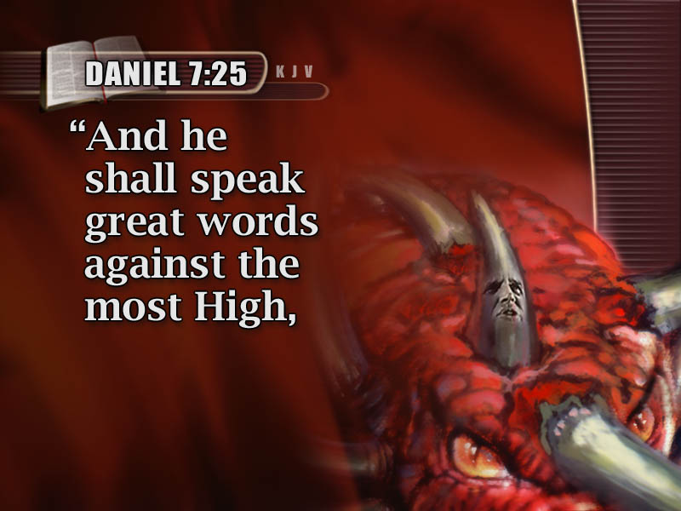

Slide 19
Notes:
This little horn power is obviously religious because it is attacking the commandments of God. What is the 3rd commandment? Thou shalt not take the name of the Lord thy God in vain. But this little horn power is blaspheming and speaking “great words against the most High.” Most people think blasphemy is taking God’s name in vain or obviously insulting or showing contempt for God. Maybe with a pitchfork and a red devil tail. But did you know the Bible’s definition of blasphemy in John 10:31-39 is really a lot more about speaking on behalf of God? This becomes obvious in the Jews’ false accusation of Christ in John 10 which reads…

Slide 20
John 10:31-33
31 Then the Jews took up stones again to stone Him. 32 Jesus answered them, “Many good works I have shown you from My Father. For which of those works do you stone Me?” 33 The Jews answered Him, saying, “For a good work we do not stone You, but for blasphemy, and because You, being a Man, make Yourself God.”
Notes:
By speaking on behalf of God, Jesus was claiming to be God. This little horn is doing the same thing. Blaspheming great words against God. Speaking on behalf of God. Though unlike Jesus, he is not God! What else does this religious little horn power do? Daniel 7:25 says he would…

Slide 21
Notes:
What is the 6th commandment the pre-incarnate Christ gave us? Thou shalt not murder. But Scripture says this little horn shall “wear out the saints of the most High.” Pretty much everybody concedes this is a reference to persecution and inquisitions and bloodshed. What people disagree about is who does the persecuting and when that took place. But everyone believes “wear out the saints” is a deadly warning about persecution and therefore, clearly a violation of the sixth commandment prohibiting murder. But what is the reference to “thinking to change times and laws?”

Slide 22
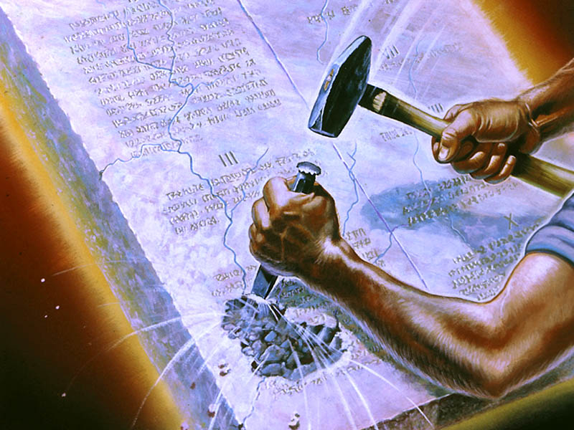
Notes:
Well, if the first two religious references in Daniel 7:25 refer to the 3rd and 6th commandments of the pre-incarnate Christ, should we be at all surprised that the third reference regarding times and laws refers to the 4th commandment of Christ? The only one of God’s laws that has anything to do with time? The one that begins with the word “Remember” because God knew the little horn would tempt us to forget?

Slide 23
Notes:
Once upon a time, the The King of Babylon, Nebuchadnezzar, had a bad dream. Which he couldn’t remember. Or understand. His wise guys couldn’t tell him the dream. Therefore, they couldn’t interpret it. So Daniel prayed about it. And God gave Daniel the King’s dream and its interpretation. And after He did, Daniel praised God saying in Daniel 2:20-21…

Slide 24
Daniel 2:20-21
20 Blessed be the name of God forever and ever, for wisdom and might are His. 21 And He changes the times and the seasons; He removes kings and raises up kings; He gives wisdom to the wise and knowledge to those who have understanding.
Notes:
Please notice that within the book of Daniel, context claims that only the true God in heaven can change the times and the seasons. He removes kings and raises up kings. But this religious little horn power in Daniel 7 that arrives after Babylon, Medo-Persia, Greece, and Pagan Rome not only blasphemes God by claiming the authority to speak for Him and persecutes the saints, he is also claiming the power that belongs to God to change times and seasons. Unlike the other kingdoms, this little horn power is a religious political power. And the apostle Paul also predicted its rise after the first century in Acts 20:28-31 which says…

Slide 25
Acts 20:29-30
29 For I know this, that after my departure savage wolves will come in among you, not sparing the flock. 30 Also from among yourselves men will rise up, speaking perverse things, to draw away the disciples after themselves.
Notes:
Paul is saying the same thing as Daniel. After Babylon, Medo-Persia, Greece, and Pagan Rome there will come another power. This one will be religious because it arises among professed believers but draws those believers away and makes them their disciples instead. In 2 Thesalonians 2:3, Paul called this same power the lawless one.

Slide 26
2 Thessalonians 2:3
3 Let no one deceive you by any means; for that Day will not come unless the falling away comes first, and the man of sin is revealed, the son of perdition, 4 who opposes and exalts himself above all that is called God or that is worshiped, so that he sits as God in the temple of God, showing himself that he is God.
Notes:
Again, blasphemy is not just obviously opposing God. Blasphemy is also exalting oneself and speaking on behalf of God as if you are God. Is this a religious political power description as well? Let’s take a look at the phrase “son of perdition.” You know where Paul got that? From Judas Iscariot. In John 17:12, Jesus prays, “While I was with them in the world, I kept them in Your name. Those whom You gave Me I have kept; and none of them is lost except the son of perdition, that the Scripture might be fulfilled.” Jesus is referring to Judas Iscariot as the son of perdition. Judas was a religious person. A disciple of Christ. Someone who on the outside looks like they’re following Jesus but on the inside is actually betraying Him.

Slide 27
2 Thessalonians 2:3
3 Let no one deceive you by any means; for that Day will not come unless the falling away comes first, and the man of sin is revealed, the son of perdition, 4 who opposes and exalts himself above all that is called God or that is worshiped, so that he sits as God in the temple of God, showing himself that he is God.
Notes:
What Paul is saying is after Babylon, Medo-Persia, Greece and in his day Pagan Rome, there will arise a religious power like Judas. A religious person. A disciple of Christ. Someone on the outside pretending to follow Jesus but on the inside betraying Him by opposing God’s laws. And leading others to do the same. Like the 1st commandment forbidding the worship of any other Gods while this rising power accepts worship. And sits as God in the temple of God.

Slide 28
2 Thessalonians 2:3
3 Let no one deceive you by any means; for that Day will not come unless the falling away comes first, and the man of sin is revealed, the son of perdition, 4 who opposes and exalts himself above all that is called God or that is worshiped, so that he sits as God in the temple of God, showing himself that he is God.
Notes:
Which by the way, is the definition of anti-Christ. In Greek, “anti” does not mean against. Anti means “in place of.” We get that confused in English but remember, the New Testament was written in Greek…

Slide 29
Jesus created Sabbath to be remembered (Psalm 33:6; 1 Corinthians 10:1-4; Genesis 2:1-4; James 4:12; Revelation 1:10; Exodus 20:10)
God warned us that Sabbath would be reviled (Daniel 7:25; Daniel 2:20-21; John 10:31-33; Acts 20:28-30; 2 Thessalonians 2:3; John 17:12)
Notes:
So point #1, Jesus created Sabbath to be remembered as a memorial of Creation. But point #2, something went drastically wrong. God knew it would be reviled. That’s why He included an Old Testament prophecy and some New Testament Scriptures warning us about the attempted change of Lord’s Day Sabbath to Sunday. Let’s see how history records what happened next after Paul’s day.

Slide 30
Notes:
Many church historians place the beginning of a gradual change of days sometime between A.D. 70 and A.D.135, the dates when two bitter and bloody insurrections by the Jews were crushed by the Romans.

Slide 31
Notes:
The mounting Roman hostility against the Jews, coupled with the conflict between Jews and Christians, encouraged a rash of anti-Jewish literature. This in turn created strong anti-Jewish sentiment throughout the Roman Empire. Christians became increasingly sensitive about being identified with the Jews. Since Sabbath-keeping tended to identify them with the Jews, many Christians began shying away from keeping the seventh day Sabbath. Dr. Samuele Bacchiocchi writes in his book, Divine rest for Human Restlessness…

Slide 34
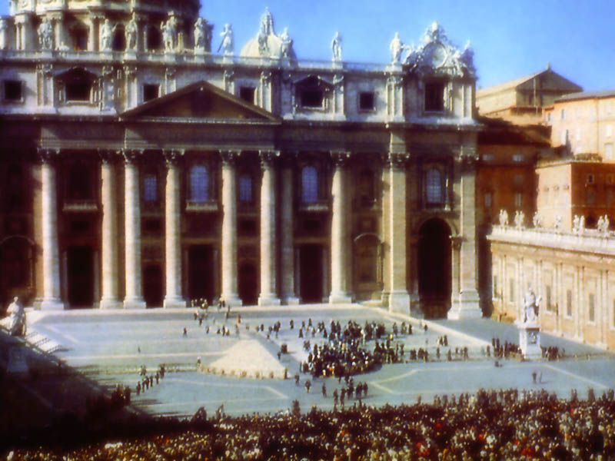
Notes:
With this in mind, it is easer to see how Christians living in the capital city of the Roman Empire led the way in disassociating themselves from Sabbath-keeping.

Slide 35
Notes:
But why was Sunday chosen rather than some other day of the week to worship on? That’s a good question. And the answer is because pagans in the Roman Empire had been sun worshipers for many years celebrating Sunday as literally the sun’s day.

Slide 36
Notes:
Furthermore, the Roman emperors represented themselves as sun gods, stamping the emblem of the sun on their coins and buildings and demanding worship from their subjects. The rising Roman church believed there would be an advantage in combining the sun’s day with the newly identified Lord’s day. They hoped worship would unite the Roman Empire.

Slide 37
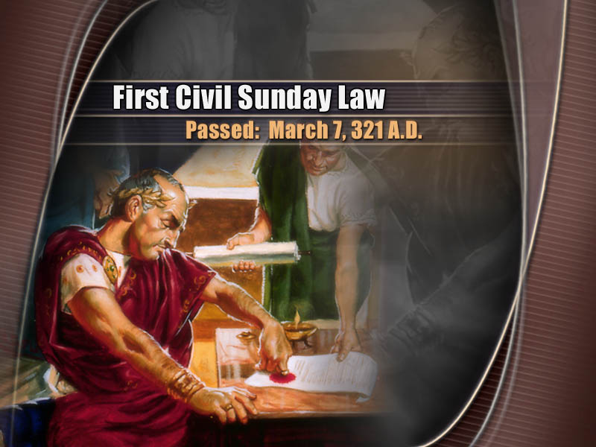
Notes:
The gradual change from our Lord’s Day Sabbath to Sunday was accented by the first civil Sunday law passed by the Roman Emperor Constantine on March 7, A.D. 321 which said among other things “on the venerable day of the Sun, let the magistrates and people residing in the cities rest, and let all the workshops be closed…” Next, historians tell us that in the year 325 AD at a church Council of Laodicea…

Slide 38
Notes:
As noted earlier, Clement of Alexendria called the Sunday the Lord’s Day first a few decades earlier, but Sylvester made it official in 325. (Historia Ecclesiastica, p. 739.) So the early 4th century AD was when the first official attempt on behalf of the church took place to indicate that Sunday was a special day to the Lord. Then almost forty years later in 364 AD, the first Sunday law concerning the observing of Sunday occurred and said…

Slide 42
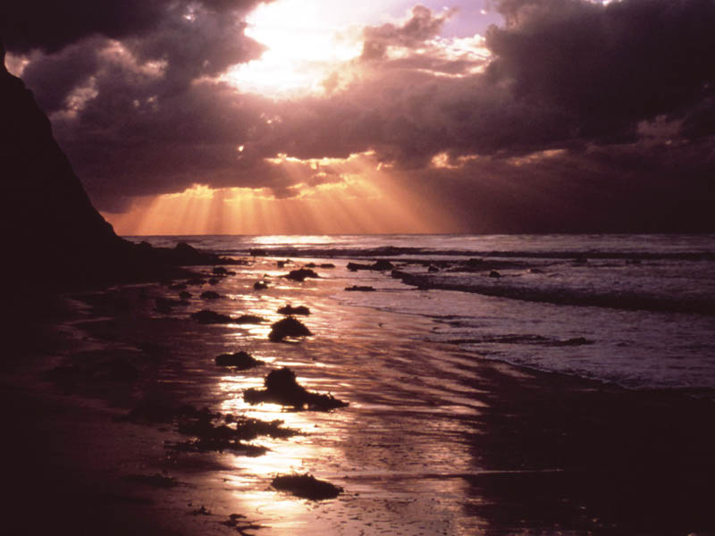
Notes:
But for centuries, while these gradual changes were taking place, faithful followers of Jesus continued worshiping our Creator on the seventh day Sabbath. There is so much data out there I couldn’t decide what to include and what to leave out so please just notice one summary slide per century. If anyone wants a copy of these next few slides, email me and I’ll send them to you. The antagonistic historian Josephus kicks off our world tour with these words…

Slide 43
First Century
There is not any city of the Grecians, nor any of the barbarians, nor any nation whatsoever, whither our custom of resting on the seventh day hath not come! – Josephus
Notes:
In the second century, one historian combines the example and command of Christ…

Slide 44
Second Century
The Sabbath was a strong tie which united them with the life of the whole people, and in keeping the Sabbath holy they followed not only the example but also the command of Jesus. – Geschichte des Sonntags, pp.13-14
Notes:
I liked this next quote from India, home of my favorite food…

Slide 45
Third Century
The Kishan Dynasty of North India called a council of Buddhist priests at Vaisalia to bring uniformity among the Buddhist monks on the observance of the weekly Sabbath. Some had been so impressed by the writings of the Old Testament that they had begun to keep the Sabbath. – Lloyd, The Creed of Half Japan, p.23
Notes:
Buddhist monks sincerely kept the Lord’s Day. Who knew? The seventh day Sabbath was also observed in Asia…

Slide 46
Fourth Century
The ancient Christians were very careful in the observation of Saturday, or the seventh day…It is plain that all Oriental churches, and the greatest part of the world, observed the Sabbath as a festival.
Notes:
Adventists like to point out that Sabbath originated in Creation long before Father Abraham and a Jewish nation existed. But that too is nothing new. People were already saying so in the Fourth Century too.

Slide 47
Fourth Century (continued)
Athanasius likewise tells us that they held religious assemblies on the Sabbath, not because they were infected with Judaism, but to worship Jesus, the Lord of the Sabbath, Epiphanius says the same. – Antiquities of the Christian Church, Vol.II, Book XX, chap.3, Sec.1, 66.1137, 1138
Notes:
Charles Bradford wrote a book called Sabbath Roots: The African Connection all about the Sabbath in Ethiopia and other places in Africa. No wonder Augustine…

Slide 48
Fifth Century
Augustine deplored the fact that in two neighboring churches in Africa one observers the seventh-day Sabbath, another fasted on it.
– Dr. Peter Heylyn, The History of the Sabbath, p.416.
Notes:
St. Patrick and a King’s grandson Columba brought the The Lord’s Day Sabbath to Scotland and Ireland in the sixth century.

Slide 49
Sixth Century
Having continued his labors in Scotland for 34 years, he [Columba converted by Patrick] clearly and openly foretold his death, and on Saturday, the ninth of June, said to his disciple Diermitt: ‘This is the day called the Sabbath, that is, the day of rest, and such will it be for me; for it will put an end to my labors.’ – Dr. Leslie Hardinge, The Celtic Church in Britain, 1972, pp.80-89
Notes:
And he was right! Because that was the day he died! But for a while, the Celtic church also observed both Sabbath and Sunday…

Slide 50
Seventh Century
The Celts used a Latin Bible unlike the Vulgate and kept Saturday as a day of rest, with special religious services on Sunday. – Flick, The Rise of the Medieval Church, p.237
Notes:
In AD 781, the famous China Monument was inscribed in marble to tell of the growth of Christianity in China at that time. The inscription, consisting of 763 words, was unearthed in 1625 near the city of Changan and now stands in the “Forest of Tablets”, Changan. The following extract from the stone shows that the Sabbath was observed in the 8th century…

Slide 51
Eighth Century
On the seventh day we offer sacrifices, after having purified our hearts, and received absolution for our sins. This religion, so perfect and so excellent, is difficult to name, but it enlightens its brilliant precepts. – M.l’Abbe Huc., Christianity in China, Vol I, ch.2, pp.48-49
Notes:
I love archaeology. This next one in the 9th century is kind of funny.

Slide 52
Ninth Century
Pope Nicholas I, in the ninth century, sent the ruling prince of Bulgaria a long document saying in it that one is to cease from work on Sunday, but not on the Sabbath. The head of the Greek Church, offended at the interference of the Papacy, declared the Pope ex-communicated. – Truth Triumphant, p.232.
Notes:
Stop telling us what to do! You’re not the boss of me! Kind of reminds me what Peter told his church leaders in Acts 5:29, “We must obey God rather than man!” In Kurdistan it was said of the Nestorians in the 10th century…

Slide 53
Tenth Century
The Nestorians eat no pork and keep the Sabbath. They believe in neither auricular confession nor purgatory. – Schaff-Herzog, The New Encyclopedia of Religious Knowledge, article “Nestorians”
Notes:
Somehow this next quote got left out of the movie My Big Fat Greek Wedding, but referring to the separation of the Greek Church from the Latin church in the famous schism of 1054 historians say…

Slide 54
Eleventh Century
The observance of Saturday is, as everyone knows, the subject of a bitter dispute between the Greeks and the Latins. – Neale, A History of the Holy Eastern Church, Vol.1, p.731
Notes:
I told the Pathfinders recently about Rachel Oakes Preston. The Seventh-day Baptist who introduced the Lord’s Day Sabbath to our early Adventist pioneers. One of her Baptist pioneers said this about the Twelfth Century…

Slide 55
Twelfth Century
There is much evidence that the Sabbath prevailed in Wales universally until AD 1115, when the first Roman bishop was seated at St.Davis’s. The old Welsh Sabbath-keeping churches did not even then altogether bow the knee to Rome, but fled to their hiding places. – Lewis, Seventh Day Baptists in Europe and America, Vol.1,p.29
Notes:
A prominent Catholic author writes the following regarding the Waldenses in the thirteenth century.

Slide 56
Thirteenth Century
They say that the blessed Pope Sylvester was the Antichrist of whom mention is made in the Epistles of St.Paul as having been the son of perdition. They also say that the keeping of the Sabbath ought to take place. – Ecclesiastical History of the Ancient Churches of Piedmont, p.169.
Notes:
Obviously, Adventists didn’t invent this Daniel 7 / Acts 20 / 2 Thessalonians 2 connection about the little horn. What I’m telling you about reviling the Lord’s Day in Point # 2 has been around for over 500 years. I told you last week my dad is British. But did you know my mother is Norwegian? And that my parents named me Michael after my great-great Grandfather Mikael who accepted the Lord’s Day Sabbath and became a lay preacher in Norway? Maybe Mikael was related in some way to the Norwegians of the 14th century who also preserved the worship of Jesus on the Lord’s Day.

Slide 57
Fourteenth Century
Then, too, in the catechism that was used during the fourteenth century, the Sabbath commandment read thus: ‘Thou shalt not forget to keep the seventh day.’ – Documents and Studies Concerning the History of the Lutherna Catechism in the Nordish Churches, p.89 Christiana: 1893.
Notes:
Norwegians also make some awesome Kranzakaza! That stacked wedding cake isn’t as good as pie, but pretty close! I have no idea where Bohemia is but watch what they were up to in the fifteenth century…

Slide 58
Fifteenth Century
Erasmus testifies that even as late as about 1500 these Bohemians not only kept the seventh day scrupulously, but also were called Sabbatarians. – Cox, The Literature of the Sabbath Question, Vol.2, pp.201-202; Truth Triumphant, p.264
Notes:
And let’s give a little love to little old Lichenstein in the 16th century…

Slide 59
Sixteenth Century
The Sabbatarians teach that the outward Sabbath, i.e. Saturday, still must be observed. They say that Sunday is the Pope’s invention. – Wolfgang Capito, Refutation of Sabbath, 1599.
Notes:
Maybe you’ve heard of John Milton? This dude was hard core.

Slide 60
Seventeenth Century
It will surely be far safer to observe the seventh day, according to the express commandment of God, than on the authority of mere human conjecture to adopt the first. – John Milton, Sab. Lit. 2, pp.46-54.
Notes:
But Tennhardt of Nuremberg, Germany would’ve given Milton a run for his money. He broke it down in the 18th century…

Slide 61
Eighteenth Century
He holds strictly to the doctrine of the Sabbath, because it is one of the ten commandments. – Bengel, Leben und Wirken, Burk, p.579
He himself says: ‘It cannot be shown that Sunday has taken the place of the Sabbath (p.366). The Lord God has sanctified the last day of the week. Antichrist, on the other hand, has appointed the first day of the week.’ – K1. Auszug aus Tennhardt’s Schriften, p.49, printed 1712.
Notes:
And then in 19th century, a bright young man by the name of John Nevins Andrews at the tender age of 17 in 1845 began to keep the Sabbath and began preaching about it in 1850 at age 21. Twenty nine years later he was still preaching about it during the dedication of the Dime Tabernacle in Battle Creek, MI when he said during his sermon…

Slide 62
Nineteenth Century
You will notice another fact, which is that God ordained the observance of this day as the memorial of his great work of creation, so that all intelligent creatures might keep God in their memory. – John Nevins Andrews, Dedicatory Sermon, 1879.
Notes:
Sounds like he clearly grasped point #1 from today’s sermon! This next one still startles me. Since it comes not from a Seventh-day Adventist sermon but a Catholic Church newsletter…

Slide 63
Twentieth Century
The holy day, the Sabbath, was changed from Saturday to Sunday…not from any directions noted in the Scriptures, but from the Church’s sense of its own power…People who think that the scriptures should be the sole authority should logically become Seventh-day Adventist, and keep Saturday holy. – Saint Catherine Catholic Church Sentinel, May 21, 1995
Notes:
Amen! Thank you Catholic friends for that ringing endorsement. And finally, paraphrasing Isaiah 58:13, we have this pithy bumper sticker from the 21st century by some crazy Pastor guy in Toledo…

Slide 64
Twenty-first Century
Kept right, it’s a delight!
– Pastor Mike, January 31, 2015
Notes:
So what’s the point?

Slide 65
Jesus created Sabbath to be remembered (Psalm 33:6; 1 Corinthians 10:1-4; Genesis 2:1-4; James 4:12; Revelation 1:10; Exodus 20:10)
God warned us that Sabbath would be reviled (Daniel 7:25; Daniel 2:20-21; Acts 20:28-30; 2 Thessalonians 2:3; John 17:12)
Sabbath reminds all of their Creator, Redeemer, and Sanctifier (Revelation 14:6-7; Exodus 20:11; Deuteronomy 5:12-15; Galatians 3:13; Galatians 4:4-7; Ezekiel 20:12; Exodus 31:13)
Notes:
The point is Jesus created the Lord’s Day Sabbath to be remembered. But Satan, Christ’s adversary on earth, has used beastly powers on earth to revile the Lord’s Day. Even attempting to change God’s times and law. But throughout history, there have been sincere people who have continued to remember the Sabbath in every century including ours. Will you like my great great grandfather Mikael be one of them? I hope so, because kept right, it’s a delight and helps us remember our Creator. It also reminds us of our Redeemer who brags about making us holy. Check out this global invitation from our Creator.

Slide 66
Revelation 14:6-7
6 Then I saw another angel flying in the midst of heaven, having the everlasting gospel to preach to those who dwell on the earth—to every nation, tribe, tongue, and people— 7 saying with a loud voice, ‘Fear God and give glory to Him, for the hour of His judgment has come; and worship Him who made heaven and earth, the sea and springs of water.’
Notes:
Non-Adventist scholars say that last part is in fact a quote from the 4th commandment in Exodus 20:11. Which reads in part…

Slide 67
Exodus 20:11
11 For in six days the LORD made the heavens and the earth, the sea, and all that is in them, and rested the seventh day. Therefore the LORD blessed the Sabbath day and hallowed it.
Notes:
So sometime after the cross but before Jesus returns, a global invitation is going to go around the world inviting people to accept the everlasting gospel and to worship their Creator on the day the LORD blessed and preserved all these years. Apparently, the real Sabbath is still important to God. But why? I think it’s because it not only reminds us of our Creator, but also reminds us of our Redeemer. Deuteronomy 5 says this…

Slide 68
Deuteronomy 5:12-15
12 ‘Observe the Sabbath day, to keep it holy, as the Lord your God commanded you. 13 Six days you shall labor and do all your work, 14 but the seventh day is the Sabbath of the Lord your God. In it you shall do no work: you, nor your son, nor your daughter, nor your male servant, nor your female servant, nor your ox, nor your donkey, nor any of your cattle, nor your stranger who is within your gates…
Notes:
Which, by the way, is another awesome Bible study on the “strangers within thy gates.” Jesus was looking out for Gentiles even in the Old Testament. The invitation to worship Him has always been about every tribe, nation, language, and people…but I digress…

Slide 69
Deuteronomy 5:12-15
…that your male servant and your female servant may rest as well as you. 15 And remember that you were a slave in the land of Egypt, and the Lord your God brought you out from there by a mighty hand and by an outstretched arm; therefore the LORD your God commanded you to keep the Sabbath day.
Notes:
What’s the additional rationale for this global invitation? Because Jesus, the LORD, has redeemed us! He said it is finished at Creation and it is finished at the cross. Galatians 3:13 reminds us of the significance…

Slide 70
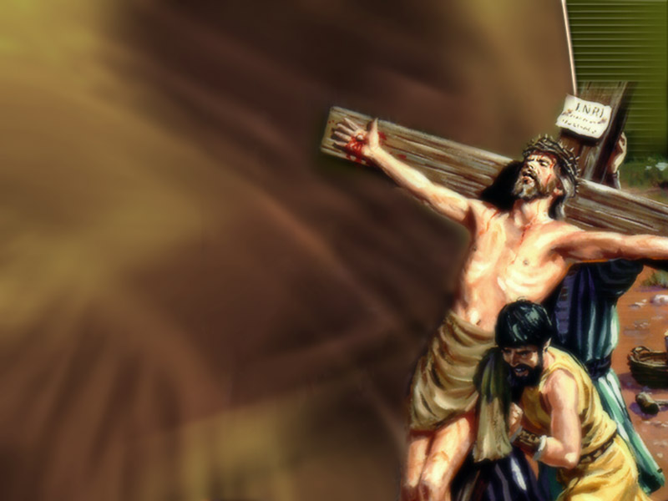
Galatians 3:13
13 Christ has redeemed us from the curse of the law, having become a curse for us (for it is written, “Cursed is everyone who hangs on a tree.”
Notes:
Chapter 4 adds these encouraging words…

Slide 71
Galatians 4:4-7
4 But when the fullness of the time had come, God sent forth His Son, born of a woman, born under the law, 5 to redeem those who were under the law, that we might receive the adoption as sons.

Slide 72
Galatians 4:4-7
6 And because you are sons, God has sent forth the Spirit of His Son into your hearts, crying out, “Abba, Father!” 7 Therefore you are no longer a slave but a son, and if a son, then an heir of God through Christ.
Notes:
Out of love for Christ, we are free to follow His commandments. To worship our Creator and Redeemer on the day He set apart as holy. God in his infinite wisdom chose Sabbath so everyone all around the world would have equal access to Him. Rich or poor. Before the cross or after. Developed nations or third world. Everyone has equal access to the Sabbath and when we gather to worship Jesus, we are all equal at the foot of the cross of our Redeemer.

Slide 73
Galatians 4:4-7
6 And because you are sons, God has sent forth the Spirit of His Son into your hearts, crying out, “Abba, Father!” 7 Therefore you are no longer a slave but a son, and if a son, then an heir of God through Christ.
Notes:
We are no longer slaves. But heirs of God through Christ. So why should we follow the traditions and counterfeits of men? Or the beastly powers and principalities of this world? The last reason I wish to share today why I think Jesus is reminding the world to worship Him on Sabbath is because Sabbath reminds us that God brags about making us holy.

Slide 74
Ezekiel 20:12
12 Moreover I also gave them My Sabbaths, to be a sign between them and Me, that they might know that I am the LORD who sanctifies them.
Notes:
Yes, Jesus created us. Yes, Jesus redeemed us. But cooler still, when you rest on the day Jesus blessed, you recall that Jesus the LORD is in charge of making you holy. That’s what sanctifies means. What does Philipians 1:6 say? “He who has begun a good work in you will complete it in you.” This is so important to God that He repeated Himself in Exodus 31:12.

Slide 75
Exodus 31:13
13 Surely My Sabbaths you shall keep, for it is a sign between Me and you throughout your generations, that you may know that I am the Lord who sanctifies you.
Notes:
Some people limit the Sabbath blessing only to Jews. But friends, Jesus wants to sanctify the whole world. Which is why even inside the commandments themselves, there is an invitation to the “stranger that is within thy gates.” The Sabbath is so important to God because it is sign of righteousness by faith. Of what God will do in you instead of what you can do in you. If you’re not resting, you’re working. So unplug. Slow down. And let God do His thing! It’s also something you can freely choose to do. Unlike the power in Revelation 13 that counterfeits, threatens, and will coerce worship of his image to the beast. We will talk about that March 14. But in the meantime, did anyone hear about Christopher Laudani this week?

Slide 76
Christopher Laudani
Notes:
According to the January 28, 2015 Boston Herald article I read by Owen Boss and O'Ryan Johnson, Christopher Laudani, the mystery shoveler who cleared the Boston Marathon finish line — and whose blizzard photo has gone viral — said recently he was compelled to clear what is considered hallowed ground in the city. Laudani, 25, said he was about to punch out of work as the blizzard raged Tuesday when he thought about the finish line. "To me. It's my favorite place in Boston," he said.

Slide 77
Christopher Laudani
Notes:
"The plows were doing a good job, but there was still an inch or so on the ground. I just said I'm going to uncover the finish line.” The shoveler’s good deed was caught by man who snapped two photos, posted them on Twitter — and set off a social media firestorm aimed at identifying the man behind the act. “I feel like just seeing it happening was a blessing and you always give away your blessings to make room for more — so that’s what I did,” the photographer, Philip L. Hillman said.

Slide 78
Christopher Laudani
Notes:
Twitter users launched a search for the mystery man using the hashtag “WhoShoveledTheFinishLine” until Laudani was revealed. And the random act of kindness was applauded by the Boston Athletic Association. “We saw profound acts of courage and kindness following the bombings which occurred in the City of Boston in April 2013 near the Boston Marathon finish line. Since that time, we have continually witnessed an outpouring of support for this great event and the City, demonstrating just how unique and special this race really is and all for which it stands,” Executive Director Tom Grilk said in a statement.

Slide 79
Christopher Laudani
Notes:
“For someone to brave the winter blizzard to clear our finish line for us is yet another statement as to what our event means not only to runners but also to Americans. We, at the Boston Athletic Association are the organizers and are responsible for the management of the Boston Marathon, but an act like we see depicted here proves that – in Boston – everyone owns the Marathon.”
The images were even featured as the Boston Police Department’s “Photo of the Day” on the department’s official website.
https://www.bostonherald.com/news_opinion/local_coverage/2015/01/marathon_finish_line_shoveler_doesn_t_think_he_did_anything
Wednesday, January 28, 2015
By: Owen Boss, O'Ryan Johnson

Slide 80
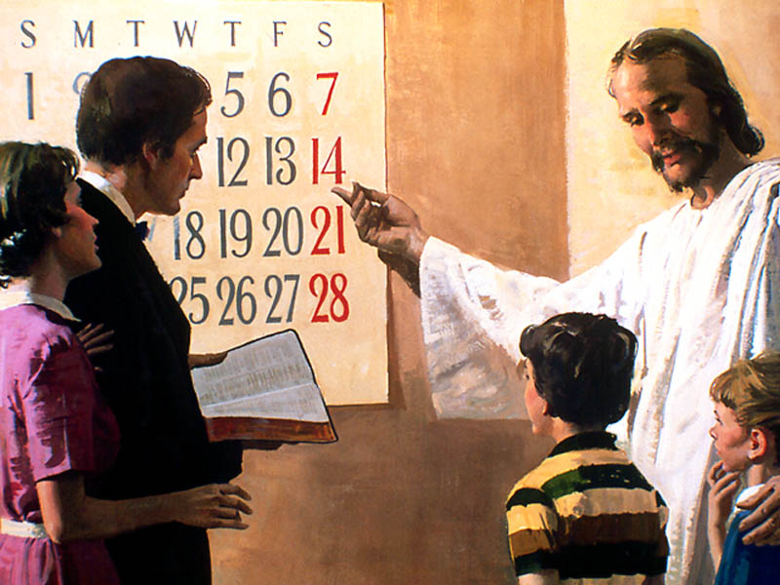
Notes:
The Sabbath is like that finish line. It’s Jesus’ delightful day and favorite time to spend with His children. Sometimes when it gets covered up, forgotten, and reviled, it needs some Jesus freaks to brush it off and inspire people to remember their Creator and Redeemer and Sanctifier who gave it to every tribe, nation, language, and people. Don’t you think doing so would bring Jesus joy? To sincerely obey not only His example but also His commands? Is that your desire? I hope so.

Slide 81
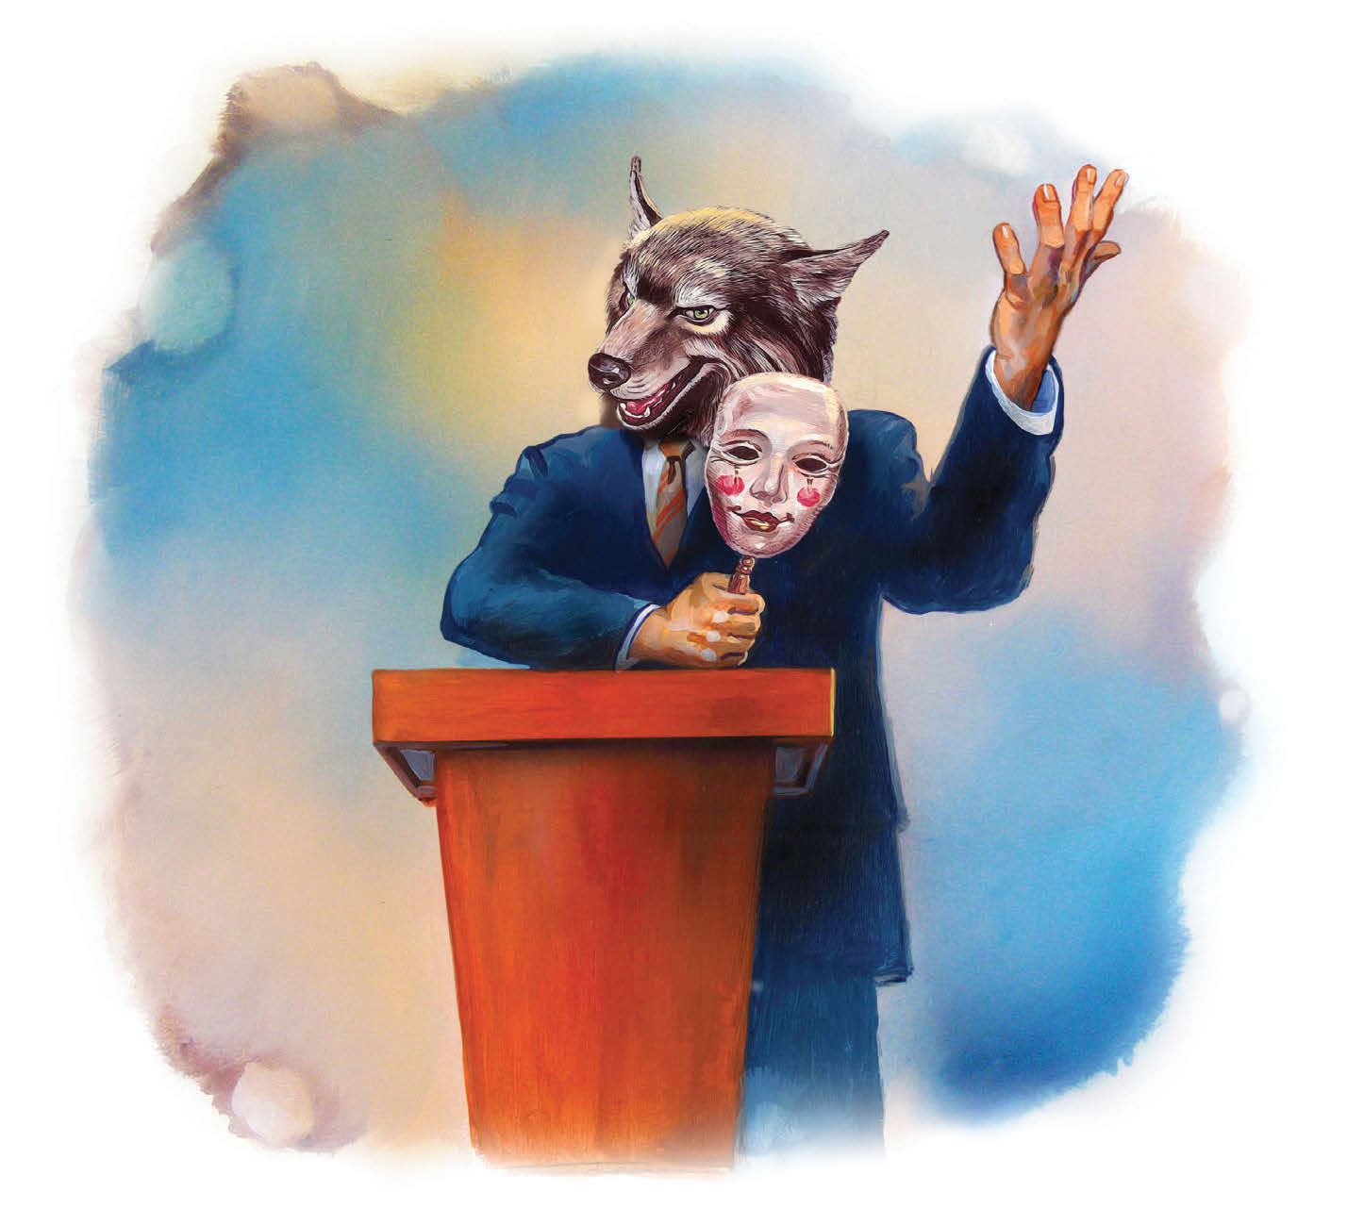
What the Bible Says About False Prophets and Deceptions
Notes:
I’ve asked four speakers to fill in for me next Sabbath while Jackie and I attend the 1Project in California – a leadership conference celebrating the supremacy of Jesus in the Seventh-day Adventist Church. So far, no takers. So we shall see if our series continues next week or not so stay tuned. And happy Sabbath!

