Slide 1
What the Bible Says About the 2,300-Year Prophecy

Slide 2
Notes:
Numbers are important to people. 12/16/90 - the date I asked Jackie to be my “girlfriend up here”. I had another one in MD. Not proud of that, but at least I was honest!

Slide 3
Notes:
10/22/95 - the date we got engaged.

Slide 4
Notes:
12/22/96 - the date we got married.

Slide 5
Notes:
8/6/99 - the date Josh was born five days late one year to the day of my dad’s stroke reminding us that God always brings something good from something bad.

Slide 6
Notes:
2/13/02 - the date Lydia arrived and I fell in love. Again.

Slide 7
Notes:
Six – the number of NBA championship rings Michael Jordan won with the Chicago Bulls. Remember when LeBron James won his second NBA championship with the Miami Heat? Some silly young guns said afterward that LeBron was better than Michael Jordan. When asked about that by a reporter, all Jordan did was hold up six fingers. Case closed.

Slide 8
Notes:
Numbers are important to people. And numbers are important to God too. As our introductory video clip conveyed through nature. In the Bible, numbers are important as well. Three - for the Father, Son, and Holy Spirit. Seven - the day God blessed and made holy. Twelve - the number of tribes of Israel and significantly, the number of leftover baskets after Jesus miraculously fed 5k Jewish families one day. Five -the number of books of the Jewish Torah and also the number of loaves of bread the little boy brought in his basket. Let’s read about that. Matthew 14:13-21 says…

Slide 9
Matthew 14:13-21
“13 As soon as Jesus heard the news, he left in a boat to a remote area to be alone. But the crowds heard where he was headed and followed on foot from many towns.

Slide 10
Matthew 14:13-21
14 Jesus saw the huge crowd as he stepped from the boat, and he had compassion on them and healed their sick. 15 That evening the disciples came to him and said, "This is a remote place, and it's already getting late.

Slide 11
Matthew 14:13-21
Send the crowds away so they can go to the villages and buy food for themselves.” 16 But Jesus said, "That isn't necessary—you feed them." 17 "But we have only five loaves of

Slide 12
Matthew 14:13-21
bread and two fish!" they answered. 18 "Bring them here," he said. 19 Then he told the people to sit down on the grass. Jesus took the five loaves and two fish, looked up toward heaven, and blessed them.

Slide 13
Matthew 14:13-21
Then, breaking the loaves into pieces, he gave the bread to the disciples, who distributed it to the people. 20 They all ate as much as they

Slide 14
Matthew 14:13-21
wanted, and afterward, the disciples picked up twelve baskets of leftovers. 21 About 5,000 men were fed that day, in addition to all the women and children!”

Slide 15
Notes:
Elizabeth Talbot in her booklet we studied at Soup for You last year entitled Matthew: Prophecy Fulfilled says this first feeding story in the Gospel of Matthew shows the Jewish audience that Jesus is the new Shepherd King in the line of David that would feed the metaphorical sheep of Israel as Ezekiel 34:23-24 predicted. But Deuteronomy 18 is the go-to passage Jewish people rely on to show that this new prophet and Messiah would be like a new-Moses capable of leading a new Exodus feeding the multitudes in a desolate place like Moses did in Exodus 16. So, imagine where their minds race when they read that Matthew 14:15 describes the place where Jesus performs this first miracle as ‘desolate’ or ‘remote.’

Slide 16
Notes:
Mark 6:40 adds another detail regarding the feeding of the 5k in his parallel account. He says the people with Jesus in the wilderness during the feeding of the 5k sat down in group of fifties and hundreds. Which according to Exodus 18:21 are two of the acceptable numbers of Jewish small groups. Jethro’s wise advice to help Moses lead one day was to divide the people into groups of 1k, 100, 50, and 10 so groups of fifties and hundreds are two numbers the people present or reading Matthew later would have readily identified with a new Moses. The point is Matthew 14 is thoroughly embedded with Jewish numbers. Pregnant with prophetic and Messianic implications. Especially when compared with other Scriptures outside the Gospel of Matthew.

Slide 17
Notes:
But if we’re good Acts 17:11 Bereans, and followers of Isaiah 28:13’s advice, carefully reading our Scriptures, comparing line upon and line with other Scriptures and precept upon precept, we might come to the same conclusion. Because Matthew 15:32-39 describes the feeding of the 4k. So let’s take a closer look at that narrative as well. In Matthew 15, he writes…

Slide 18
Matthew 15:32-39
“32 Then Jesus called his disciples and told them, "I feel sorry for these people. They have been here with me for three days, and they have nothing left to eat. I don't want to send them away hungry, or they will faint along the way.”

Slide 19
Matthew 15:32-39
33 The disciples replied, "Where would we get enough food here in the wilderness for such a huge crowd?” 34 Jesus asked, "How much bread do you have?” They replied, "Seven loaves, and a few small fish.”
Notes:
READ SLIDE FIRST: Is this the same story? No, this is not the same story. In Matthew 14, there were five loaves and two fish. In Matthew 15, there are seven loaves and a few fish. This is a different story. In a different place. With a different audience. With different numbers. But the same point. Numbers are important to people. And numbers are really important to God! Because rightly understood, they help people believe in Him. And trust His plans for them. Especially when it looks like the wicked in the world are winning. Matthew 15:35 continues…

Slide 20
Matthew 15:32-39
“35 So Jesus told all the people to sit down on the ground. 36 Then he took the seven loaves and the fish, thanked God for them, and broke them into pieces. He gave them to the disciples, who distributed the food to the crowd.

Slide 21
Matthew 15:32-39
37 They all ate as much as they wanted. Afterward, the disciples picked up seven large baskets of leftover food. 38 There were 4,000 men who were fed that day, in addition to all the women and children. 39 Then Jesus sent the people home, and he got into a boat and crossed over to the region of Magadan.”

Slide 22
Notes:
Again, Elizabeth Talbot is spot on in her commentary (Ibid., 41). “In this story,” she writes, “The numbers have changed from five and twelve to seven and four. These numbers represent those on the other side.” “‘The other side’ is usually a loaded phase in the Gospels; it means ‘outsiders’” (Ibid., 39). The number four therefore in Scripture is used to highlight people who come from the four corners of the earth. What are the four corners of the earth? North. South. East. West. Revelation 7:1 clarifies that four angels are standing at the four corners of the earth holding back the four winds of strife so they do not blow on the earth or the sea.

Slide 23
Notes:
Ravi Zacharias says if it weren’t for God’s intervention, there would catastrophic Katrina like events, deadly tsunami’s and devastating earthquakes literally every day. The question is not: Why do bad things happen? The question is: Why don’t even more bad things happen every day? And the answer is found in the “Fantastic Four”

Slide 24
Not these four
Notes:
Not these four. (Marvel comic books should send me some remuneration for this shameless plug. Why is four fantastic? It’s not because these four are fantastic.

Slide 25
THESE four are fantastic!
Notes:
But because these four are fantastic! Because God’s angels are holding back the devil and his minions from wreaking total havoc on this earth. Whether they admit it or not, even atheists owe their lack of faith in God to God. And His angels.

Slide 26
Notes:
Regarding the number seven, Talbot adds from the same source, “In the non-Jewish/Gentile geographical setting, seven symbolizes one basket per nation displaced by Israel in the land of Canaan” (Ibid.,41). Her proof can be found outside the Gospel of Matthew in Acts 13:19 where it says, “Then he [God] destroyed seven nations in Canaan and gave their land to Israel as an inheritance. 20 All this took about 450 years.” The number seven, she continues, “is used in other Hellenistic settings, such as the choosing of the seven deacons with Greek names in Acts 6:1-6. The word for baskets in both stories is different. The one in Matthew 14 is often associated with Jewish audiences. The other befitting a Gentile audience” (Ibid., 42).

Slide 27
Notes:
As I shared on New Year’s Eve, during our Candle Light Agape & 1Q Communion for 2015, Jesus is the bread of life for Jews and Gentiles! He’s got the whole world in His hands. Literally. When with the Passover bread in his hands He said, “Take eat, this is My Body broken for you” what He was saying to Jews and Gentiles and Atheists and Adventists is that I am more than enough for you. In 2015, my grace is sufficient for you!

Slide 28
Notes:
I did not come into the world to confuse the world with big numbers and prophecies. 2 Peter 1:19 says those are there to point people to Jesus the morning star of prophecy.

Slide 29
Notes:
And that simultaneously as terrorists rejoice as they blow up another building or make another Christian flee from their homes or storm bastions of free speech to murder the journalists inside, their actions are not being ignored. They may evade the authorities on this earth. But not the One in heaven. Because a pre-advent judgment in the saints favor is simultaneously a judgment against the little horn and the beastly powers of this wicked world.

Slide 30
Notes:
But before we go there, please note: Matthew’s narrative about the feeding of the 5k point the reader outside of Matthew to the writings of Moses and David and Isaiah and Ezekiel. Matthew’s narrative about the feeding of the 4k point us outside of Matthew to the writings of Acts and Revelation. But many Christians miss the significance of these numbers because they dismiss the significance of prophetic numbers. Especially when compared with other numbers in Scripture.

Slide 31
Notes:
So if you’re not convinced about the numerical details of Matthew 14 and 15 and you think I’m going Beautiful Mind on you like Russell Crowe in that 2001 movie about the schizophrenic math genius, I will encourage you to read the context of the stories that take place between the two miraculous feedings of the 5k and the 4k in the Gospel of Matthew. In one you will notice an obviously Jewish discussion about ceremonial washing of the hands found in Matthew 15:1-20.

Slide 32
Notes:
But in the next, Jesus leaves the region of Jewish Galilee and traveling north to the region of Tyre and Sidon where He runs into a woman who pleads with Him to heal her daughter who is demon possessed. You can read about that in Matthew 15:21-28. Tyre and Sidon are Gentiles communities not Jewish.

Slide 33
Numbers are important to God (Matthew 14:13-21; Acts 17:11; Isaiah 28:13; Matthew 15:32-39)
The 2,300 year prophecy is important to God and His saints (Daniel 8:13-14; Daniel 9:24-27; Ezekiel 4:6; Daniel 7:8-9,11,21-23; Leviticus 16:30)
The 2,300 year prophecy warns a wicked world that a just God already is already judging them (Psalm 73:1-17; Revelation 6:10; Acts 24:25; Psalm 96:11-13)
Notes:
So Mike, what’s the point? I thought this sermon was supposed to be about What the Bible Says About the 2,300 Year Prophecy. It is. And we will get to that next and why it matters in points two and three. But before we do, could we just hit the pause button for a few moments, take a deep breath and pour ourselves a cup of tea? I’d like a biscuit with mine if we could. Grandpa Jessop knows what I’m talking about. So does my British father loves tea and when its -1 outside, I gotta say I’ve been enjoying some lately too. And while we’re enjoying our tea, let’s pause and ask ourselves a few questions regarding point number one.

Slide 34
Question 1
Notes:
If tiny numbers are so important to God that he embeds that much detail and explanation to a couple different stories about a few loaves and fish, question one, what makes us think God isn’t even more interested in the longest time prophecy recorded in Scripture? 2,300 is a pretty big number!

Slide 35
Question 2
Notes:
Question 2: Why when Adventists use scriptures with numbers outside the book of Matthew to interpret story details inside the book of Matthew are we lauded for sound scholarship but criticized for doing the exact same thing when identifying the days as years inside and outside the book of Daniel? Which leads us to one more related question:

Slide 36
Question 3
Notes:
And question 3: Do we know that Adventists didn’t make this hermeneutical days are also years in Bible prophecy thing up in some cornfield or barn? William Miller didn’t make it up either. Years later, he added some additional proofs he called them that our church and its leaders never endorsed. So the year / day principle, “It cannot rightly be called an invention, a discovery; it is, in reality, a continuation and restoration of prophetic truths and principles progressively adopted over the centuries” (Questions on Doctrine, p.316). The Greek Septuagint, a translation of the old testament written in the 3rd Century BC, was actually the first translation where scholars used the day to year principle to translate "seventy weeks" as "weeks of years“ in Daniel 9.

Slide 37
Numbers are important to God (Matthew 14:13-21; Acts 17:11; Isaiah 28:13; Matthew 15:32-39)
The 2,300 year prophecy is important to God and His saints (Daniel 8:13-14; Daniel 9:24-27; Ezekiel 4:6; Daniel 7:8-9,11,21-23; Leviticus 16:30)
The 2,300 year prophecy warns a wicked world that a just God already is already judging them (Psalm 73:1-17; Revelation 6:10; Acts 24:25; Psalm 96:11-13)
Notes:
Point number one: Numbers are important to God. Therefore, point number two, the 2,300 year prophecy is important to God too. But not just God, also His saints. But why? Let’s look at that next in point number two. The 2,300 year prophecy is found in the book of Daniel.

Slide 38
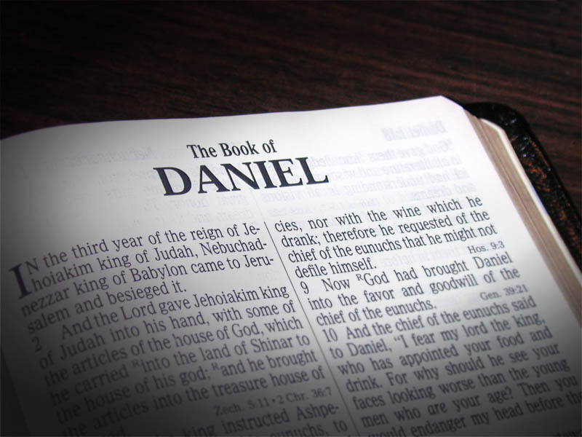
Notes:
Daniel is a great book to read and study in small groups. Especially chapter 8. It’s like a zoo with no bars. You got beasts coming up here, beasts coming up there, animals beating up animals, horns breaking off horns, new horns growing back, horns growing out of horns, all symbolizing earthly rulers and kingdoms throughout history which we don’t have time to tackle this morning but when we get to the end of all that, you arrive at Daniel 8:13-14 which reads…

Slide 39
Daniel 8:13-14
13 Then I heard two holy ones talking to each other. One of them asked, "How long will the events of this vision last? How long will the rebellion that causes desecration stop the daily

Slide 40
Daniel 8:13-14
sacrifices? How long will the Temple and heaven's army be trampled on?" 14 The other replied, "It will take 2,300 evenings and mornings; then the Temple will be made right again."
Notes:
A wordier but more specific way to say ‘day’ in Hebrew is ‘evenings and mornings’ since that is what a day consists of. Other commentators delight in saying that days can also sometimes refer to unspecified periods of time and that’s true too. But in Bible prophecy, especially this one, God inspired Daniel to be specific and unusual. To help us understand that God is talking about one day with one evening and one morning. So we will see when compared with other Scriptures about numbers that this day is also a year when discussed in prophecy.

Slide 41
Daniel 8:14 (NKJV)
14 And he said to me, “For two thousand three hundred days; then the sanctuary shall be cleansed.”
Notes:
The NKJV says verse 14 way.
This is the longest time prophecy recorded in Scripture. When Daniel heard it, just like years later when William Miller read it over 2k years later, he immediately thought of the sanctuary on earth not the one in heaven. When Daniel read it, he thought it meant that he and his people must remain in Babylonian captivity for much longer than the 70 years the prophet Jeremiah had already said.

Slide 42
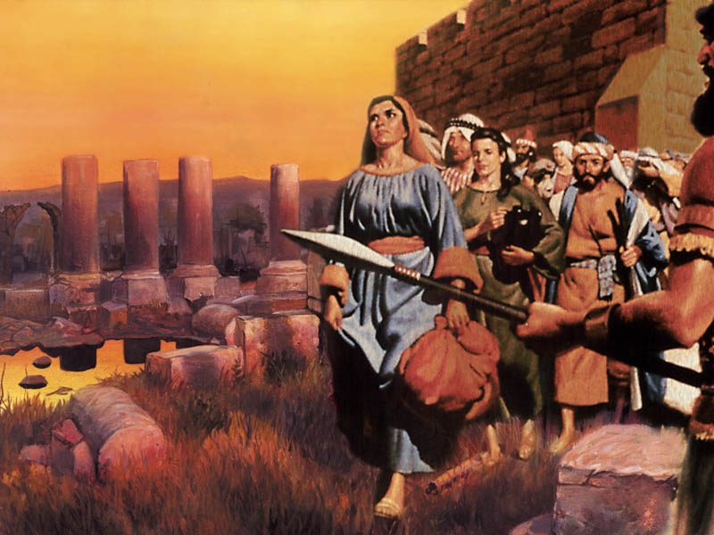
Notes:
Remember that Daniel and his people had been human trafficked into Babylonian captivity. The temple in Jerusalem, along with the rest of the city, lay in ruins. But Daniel found hope in the prophecy of Jeremiah 25:11, which predicted that their exile would only last for seventy years. Daniel knew that these seventy years were just about finished! He was looking forward to Jerusalem’s restoration! But now Daniel thought that this prophecy could mean it would still be many more years before the temple and the city would be restored. That is why he got sick and fainted according to Daniel 8:27.

Slide 43
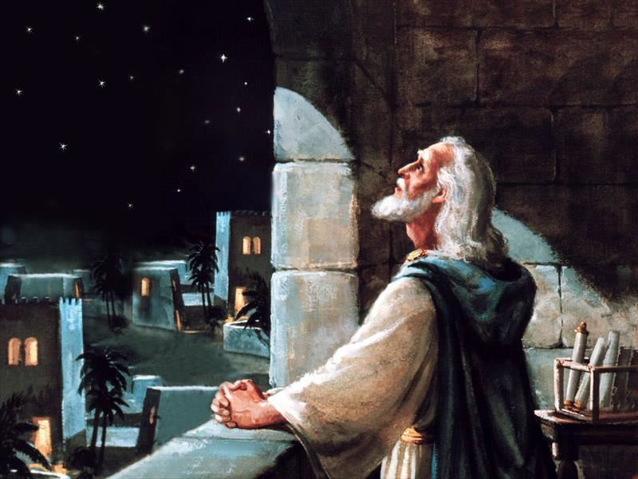
Notes:
So in Daniel, chapter 9 we find the prophet studying again the prophecy of Jeremiah, and praying earnestly, repentantly for God’s mercy upon His people.

Slide 44
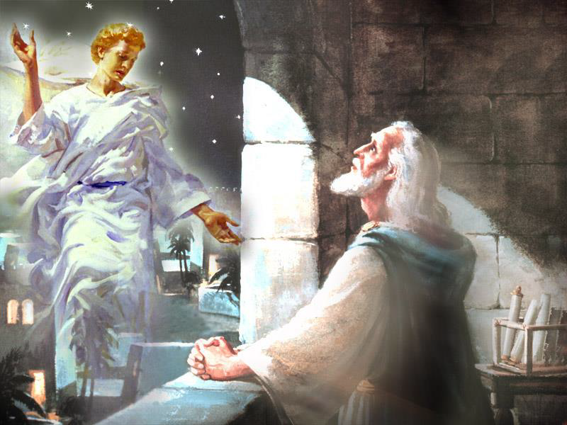
Notes:
In response to his prayer, the angel Gabriel was again sent to finish explaining the vision and give Daniel skill to understand it.
This time, Gabriel tells Daniel to “consider the vision” and begins right where Daniel had previously fainted, with an explanation of the 2300 day year period.

Slide 45
an end
of sins,
Notes:
Let’s begin by reading Daniel 9:24. “Seventy weeks are determined for your people and for your holy city, to finish the transgression, to make an end of sins,

Slide 46
Notes:
to make reconciliation for iniquity, to bring in everlasting righteousness, to seal up the vision and

Slide 47
Notes:
prophecy, and to anoint the Most Holy.”

Slide 48
Notes:
“Know therefore and understand, that from the going forth of the command to restore and build Jerusalem until Messiah

Slide 49
Notes:
the prince there shall be seven weeks and sixty-two weeks; the street shall be built again,

Slide 50
Notes:
and the wall, even in troublesome times.”
Daniel must have been extremely relieved when he understood that the restoration of Jerusalem would mark the beginning of the 2300-day prophecy, not the end!
Let’s continue reading.

Slide 51
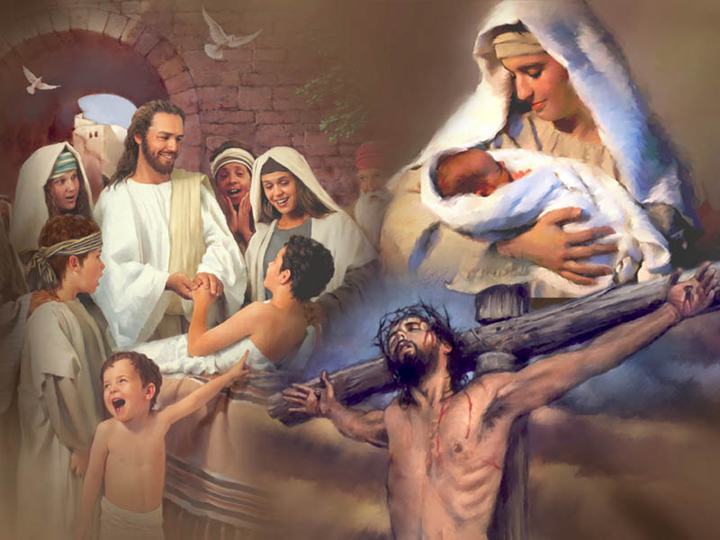
Notes:
Some of you may recall that at this time last year, I shared a two part mini-series based on Daniel 9:24-27. These verses which continue beyond verse 25 through verse 27 address:
The timing of the rebuilding of Jerusalem – (This is important because everything is based off of that date)
The advent of the Messiah – (This proves that Jesus is the Messiah)
Jesus’ death in our behalf – (This proves that the Messiah died for our sins and we can have eternal life because He did)
And the gospel going to the gentiles – (This is important to us because we are probably all here as a result of this)
This morning, what we’re most interested in is the timing of the cleansing of the Sanctuary and what it means to us.

Slide 52
Notes:
To figure that out, God sent Gabriel to tell Daniel to figure out the 70 weeks first. Daniel 9:24 stated “Seventy weeks are determined for your people.” The Hebrew word ‘chathak’ translated ‘determined’ is not used anywhere else in the Bible but was later used everywhere for “cut off.” Seventy weeks, representing 490 years, are declared by the angel Gabriel to be cut off and reserved for the Jewish nation to decide what to do with Jesus. But cut off from what? Since the 2,300 day / year prophecy was the only period of time previously mentioned in chapter 8, it is the period from which the seventy weeks of years are cut off.

Slide 53
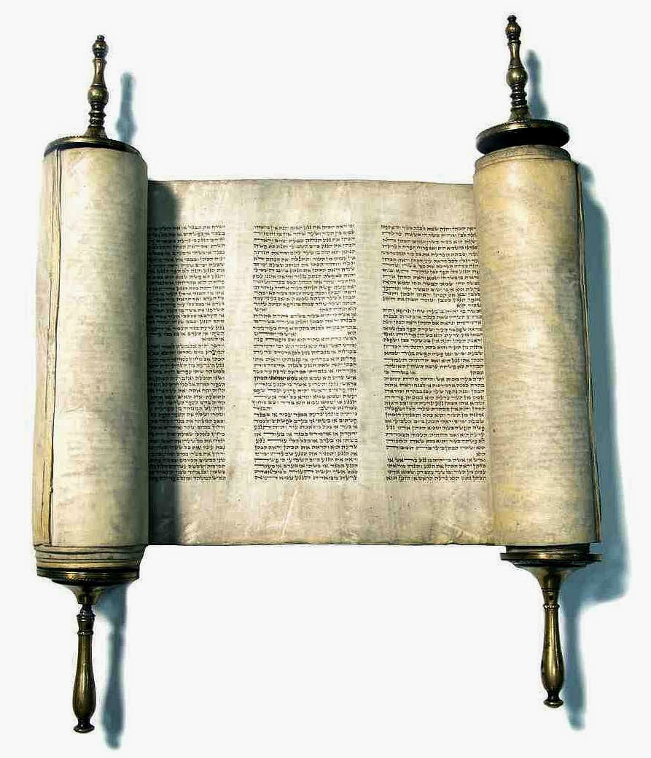
Notes:
Again, Adventists didn’t make this up. Millerites didn’t make this up. Scholars have been replacing days for years in Bible prophecy since the 3rd century BC. Comparing Scripture with Scripture works inside the Gospel and outside the Gospel of Matthew. And it works inside and outside the book of Daniel. What Gabriel was trying to help us understand is if you know when the 490 weeks of years begins, you know when the 2,300 years begins too. So when do the 490 weeks begin? Daniel 9:25 said…

Slide 54
Notes:
And when was there a command to restore and build Jerusalem? We find the answer to this word problem in the Old Testament prophet writings of the Ezra. Ezra 7 says…

Slide 55
Notes:
So the Bible says the start date for the 490 weeks of years and the 2,300 days of years begins begins at the decree to restore and build Jerusalem. And Ezra says that decree was made in the seventh year of King Artaxerxes. And history says the seventh year of King Artaxerxes took place in the year 457 BC.

Slide 56
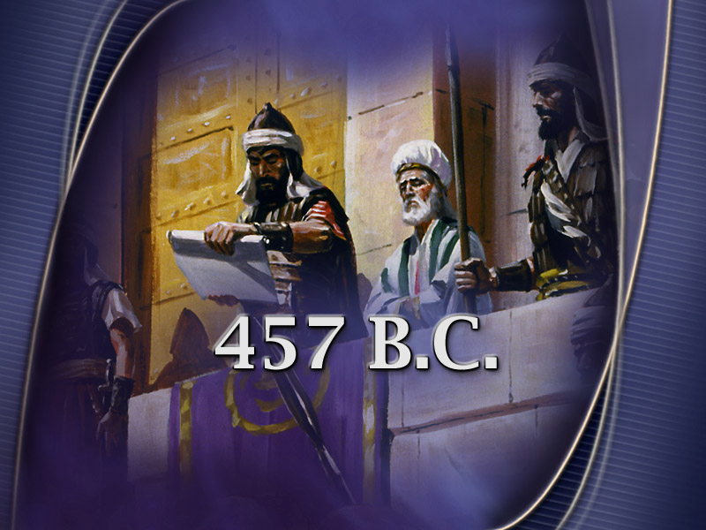
Notes:
You can also find proof of this on archaeological cylinders recovered and housed in the British Museum. Literally priceless artifacts confirming the validity of these prophecies and of Scripture. So the bible and historically approved archaeological evidence documents that the decree to restore and build Jerusalem happened in 457 B.C.

Slide 57
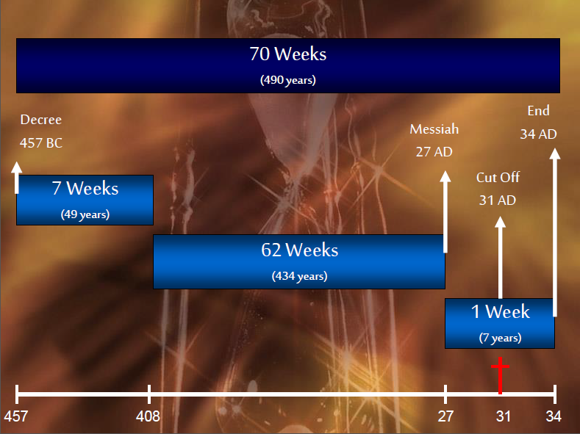
2300 Day
2300 Years
Notes:
This chart summarizes our content so far on Daniel 9:24-27.
70 weeks of years, as the Septuagint accurately interprets it, equivalent to 490 years were given to the Jewish nation to repent and accept Jesus as the Messiah or the gospel would go to the gentiles
483 years of that time would pass before Messiah would be anointed…and at Jesus’ baptism Luke 3:1-6 records in the 15th year of Tiberius Caesar, Jesus was anointed at his baptism
The last 7 years of the prophecy would be a covenant predicted to begin at Jesus baptism…
The Messiah’s death was predicted right in the middle of that covenant…It too happened as foretold.
And after the Jewish nation rejected Jesus, He still gave them 3 ½ more years to decide…But after that, they stoned Stephen and the gospel went as promised to Gentiles via the Apostle Paul.
Which is why we’re here! But because Gabriel said these prophecies share the same starting point, the 490 weeks of years also tells us when the 2,300 days of years begins.

Slide 58
Notes:
Remember what Daniel 8:14 said?

Slide 59
Notes:
Do you know what Ezekiel said?

Slide 60
2300 Days
2300 Years
70 Weeks
490 years
Gospel to
Gentiles
7 Weeks
49 years
62 Weeks
434 years
Covenant With Jews
1 Week
7 years
Decree
Issued
Messiah
Anointed
Messiah
Crucified
???
31 A.D.
457 B.C.
408 B.C.
27 A.D.
34 A.D.
1844
Notes:
So if the 490 weeks of years are cut off from the previously mentioned 2,300 days of years, our chart would look like this when spanning 2,300 years from 457 BC bringing us to 1844 AD. And after this longest time prophecy in scripture expires, obviously important Gabriel, the nation of Israel, the prophet Daniel and God, who else would see significance in its fulfillment? Us.

Slide 61
Numbers are important to God (Matthew 14:13-21; Acts 17:11; Isaiah 28:13; Matthew 15:32-39)
The 2,300 year prophecy is important to God and His saints (Daniel 8:13-14; Daniel 9:24-27; Ezekiel 4:6; Daniel 7:8-9,11,21-23; Leviticus 16:30)
The 2,300 year prophecy warns a wicked world that a just God already is already judging them (Psalm 73:1-17; Revelation 6:10; Acts 24:25; Psalm 96:11-13)
Notes:
Point number one: numbers are important to God. Point number two: the 2,300 year prophecy is important to God too. But not just God, also His saints. But why? Daniel 7 and Leviticus 16 tell us why.

Slide 62
Daniel 7:8-9
8 As I was looking at the horns, suddenly another small horn appeared among them. Three of the first horns were torn out by the roots to make room for it. This little horn had eyes like human eyes and a mouth that was boasting arrogantly. 9 I watched as thrones were put in place and the Ancient One sat down to judge...
Notes:
At the expiration of the 2,300 year prophecy, while on earth there are beastly wicked powers warring against God and God’s people, simultaneously in heaven thrones are put in place and God sits down to judge.

Slide 63
Daniel 7:11,21-23
11 I continued to watch because I could hear the little horn's boastful speech...21 As I watched, this horn was waging war against God's holy people and was defeating them, 22 until

Slide 64
Daniel 7:11,21-23
the Ancient One—the Most High—came and judged in favor of his holy people. Then the time arrived for the holy people to take over the kingdom. 23 Then he said to me, "This fourth beast is the fourth world power that will rule the earth.
Notes:
While Daniel was watching the courtroom judgment above him in heaven, notice that Daniel 7:11 says he could simultaneously hear the little horn’s boastful pompous blasphemous words on earth. So this judgment in heaven takes place while there are wicked beastly powers on earth. Context within Daniel 7says this judgment takes place before the great white throne judgment of Revelation 20. We know this is true because it takes place before the time arrives for the holy people of God to inherit the kingdom. This pre-advent judgment in heaven takes place while the fourth world power rules and will continue to rule until Christ comes. But the good news embedded inside all this bad news is that God rules in favor of the saints.

Slide 65
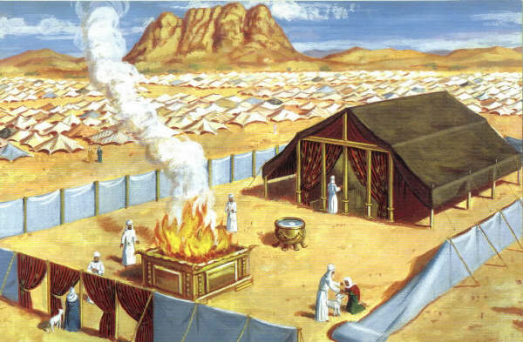
Notes:
Just like He did every year on the Day of Atonement. Which you can read about in Leviticus 16. A bunch of stuff happened on that day but the best news that could be proclaimed occurred at the end of that service and is found in verse 16.

Slide 66
Notes:
“For on that day the priest shall make atonement for you, to cleanse you,

Slide 67
Notes:
Once a year, God cleansed not only each person but also the sanctuary itself. Do you see why Daniel 8:14 said:

Slide 68
Notes:
The cleansing of the sanctuary was the last thing God did to atone for His people.

Slide 69
Numbers are important to God (Matthew 14:13-21; Acts 17:11; Isaiah 28:13; Matthew 15:32-39)
The 2,300 year prophecy is important to God and His saints (Daniel 8:13-14; Daniel 9:24-27; Ezekiel 4:6; Daniel 7:8-9,11,21-23; Leviticus 16:30)
The 2,300 year prophecy warns a wicked world that a just God already is already judging them (Psalm 73:1-17; Revelation 6:10; Acts 24:25; Psalm 96:11-13)
Notes:
Point number one: numbers are important to God. Point number two: the 2,300 year prophecy is important to God too. But not just God, also His saints. Why? Because Daniel 7 and Leviticus 16 tell us that He rules in favor of the saints. And like the Israelites after the Old Testament sanctuary was cleansed and the people have been atoned for, forgiven and declared clean.

Slide 70
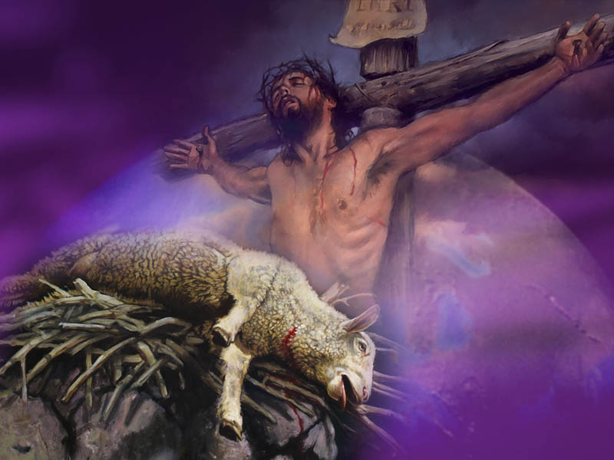
Notes:
So we shouldn’t be surprised to see Jesus as our Sacrifice on the cross and High Priest and Advocate in the sanctuary in heaven as the books of Hebrews and 1 John teach us. Because rightly understood, the cleansing of the heavenly sanctuary or pre-advent judgment as Daniel calls it is not only Biblical, it is also good news for God’s people who have longed for the day to arrive when God would rule in their favor. Because Jesus the sacrificial lamb died, in the heavenly judgment taking place right now, they’re winning. Read Zechariah 3:1-5 for more on that. And simultaneously, when the 2,300 year prophecy expires it also points people to the pre-advent heavenly judgment scene where the saints not only win but the little horn and wicked beastly powers will lose.

Slide 71
Psalm 73:11-17
11 "What does God know?" they ask. "Does the Most High even know what's happening?" 12 Look at these wicked people—enjoying a life of ease while their riches multiply. 13 Did I keep my heart pure for nothing? Did I keep myself innocent for no reason? 14 I get nothing but trouble all day long;
Notes:
Listen to how the Psalmist poetically conveys this longing for justice and warning for the wicked:

Slide 72
Psalm 73:11-17
every morning brings me pain. 15 If I had really spoken this way to others, I would have been a traitor to your people. 16 So I tried to understand why the wicked prosper. But what a difficult task it is! 17 Then I went into your sanctuary, O God, and I finally understood the destiny of the wicked.
Notes:
You see, the earthly and heavenly sanctuary were models to help us understand the victory of the saints and demise of the wicked. That’s why Psalm 13:1-2; Psalm 35:17; and Habakkuk 1:2 long for the judgment to begin. Rightly understood, we should too! And the good news is it already has. How long must we wait while the wicked prosper?

Slide 73
Revelation 6:10
10 And they cried with a loud voice, saying, 'How long, O Lord, holy and true, until You judge and avenge our blood on those who dwell on the earth?'
Notes:
Not long! Roy Adams, in the Ministry magazine article I read from August 2014 with an article entitled “The Cry for Justice and the Answer from the Sanctuary” is right when he says, “We believe, of course, in mercy. We believe in grace. Where would any of us be without these? Really! But I noticed that when Paul, the unequaled champion of grace among early Christian leaders, appeared in Felix’s court, his message” to this wicked ruler in Acts 24:15 included a discussion about…

Slide 74
Acts 24:25 (NRSV)
25 And as he discussed justice, self-control, and the coming judgment, Felix became frightened and said, 'Go away for the present; when I have an opportunity, I will send for you.'
Notes:
“…Justice, self-control, and the coming judgment.” And when Felix heard that he wasn’t gonna get away his wickedness, he became frightened and said, 'Go away for the present; when I have an opportunity, I will send for you.’ Paul didn’t use these words penned by the elderly Apostle John 40 years later in Revelation 14:7 but the message is the same:

Slide 75
Revelation 14:7
7 "Fear God," he shouted. "Give glory to him. For the time has come when he will sit as judge.

Slide 76
Numbers are important to God (Matthew 14:13-21; Acts 17:11; Isaiah 28:13; Matthew 15:32-39)
The 2,300 year prophecy is important to God and His saints (Daniel 8:13-14; Daniel 9:24-27; Ezekiel 4:6; Daniel 7:8-9,11,21-23; Leviticus 16:30)
The 2,300 year prophecy warns a wicked world that a just God already is already judging them (Psalm 73:1-17; Revelation 6:10; Acts 24:25; Psalm 96:11-13)
Notes:
Point number one: numbers are important to God. Point number two: the 2,300 year prophecy is important to God too. But not just God, also His saints. Because it points us to the pre-advent judgment now in session where Jesus our Advocate is defending us and simultaneously judging the wickedness in the world. These terrorists and dictators and unjust rulers are not going to get away with it.

Slide 77
Notes:
Roy Adams in that same August 2014 issue of Ministry magazine tells the heart breaking story of Romeo Dallaire. Maybe you remember the name? “On assignment for the United Nations in Rwanda during its genocide, retired Canadian three-star army general Romeo D’Allaire pleaded in vain to his superiors for help—for food, medicine, and material—and ‘just 3,000 combat troops.’ But tragically, the UN never responded.

Slide 78
Notes:
The memory of that catastrophic nightmare, and particularly of his own impotence in the wake of that dark evil, shattered D’Allaire’s mental equilibrium and sent him into psychiatric counseling and therapy. At one point, he was downing nine tranquilizers and antidepressants a day to keep from going crazy. In a television interview…in February 2001, D’Allaire openly confessed to ABC’s Kevin Newman that he stood at that time on the verge of committing suicide (Kevin Newman, “Nightline: UN Soldier Struggles with Past,” Nightline, broadcast February 7, 2001, accessed June 17, 2014.
Adams concludes, “The outrage against injustice lies buried deep within the human psyche.”

Slide 79
Notes:
“Simply put, judgment in the context of the heavenly sanctuary is God’s action to hold accountable the perpetrators of evil and injustice on this planet and in the cosmos…” “The cry for justice becomes louder with every passing day. But with that cry also comes the increasing realization of the inadequacy of human justice. What human court could adequately take on the human animals that have engineered the bloody horrors and massacres across the centuries? Some of the crimes committed are too complex and entrenched for human justice to unravel. And some of the criminals are too powerful and well connected for human courts to prosecute. That is why we need a judge big enough to take on the system…We need a judge who is absolutely beyond corruption or intimidation. That Judge is Christ, before whose judgment seat the saints long to appear. And before whom the wicked should quake with fear. That’s why Psalm 96 says…

Slide 80
Psalm 96:11-13
11 Let the heavens be glad, and the earth rejoice! Let the sea and everything in it shout his praise! 12 Let the fields and their crops burst out with joy! Let the trees of the forest rustle with praise 13 before the LORD, for he is coming! He is coming to judge the earth. He will judge the world with justice, and the nations with his truth.

Slide 81
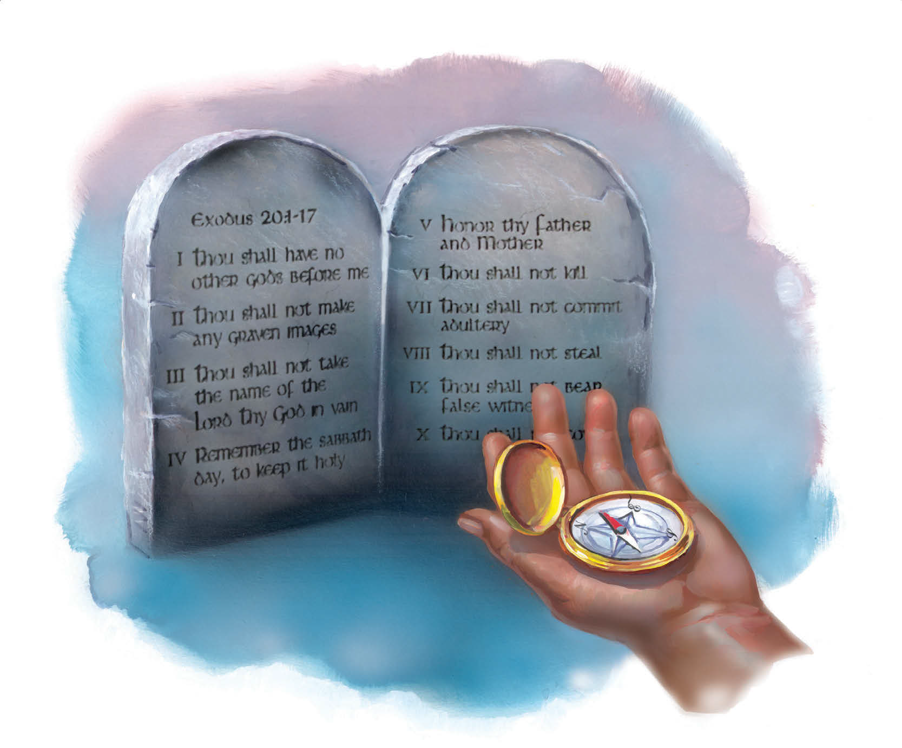
What the Bible Says About the Law of God
Notes:
Next week I’m gonna talk about the Law of God and why its still good in God’s hood. If you’d like a handout of some of the content I shared this morning, one will be available after church in the foyer.

Slide 82
2300 Days
2300 Years
70 Weeks
490 years
Gospel to
Gentiles
7 Weeks
49 years
62 Weeks
434 years
Covenant With Jews
1 Week
7 years
Decree
Issued
Messiah
Anointed
Messiah
Crucified
Pre-Advent
Judgment
31 A.D.
457 B.C.
408 B.C.
27 A.D.
34 A.D.
1844

